Slide 1
Statistics
Parameswari Ettiappan

Slide 2
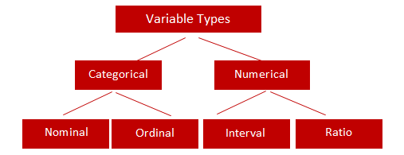
Types of Variables

Slide 3
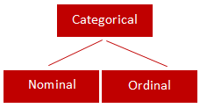
Categorical
Qualitative data are often termed categorical data.
Data that can be added into categories according to their characteristics.
Examples are gender, social class and blood types

Slide 4
Nominal Variable (Unordered list)
A variable that has two or more categories, without any implied ordering.
Examples : Gender - Male, Female
Marital Status - Unmarried, Married, Divorcee
State - New Delhi, Haryana, Illinois, Michigan

Slide 5
Ordinal Variable (Ordered list)
A variable that has two or more categories, with clear ordering. Examples :
Scale - Strongly Disagree, Disagree, Neutral, Agree, Strongly Agree
Rating - Very low, Low, Medium, Great, Very great

Slide 6
Interval
An interval variable is similar to an ordinal variable, except that the intervals between the values of the interval variable are equally spaced.
In other words, it has order and equal intervals.
Examples :
Temperature in Celsius - Temperature of 30°C is higher than 20°C, and temperature of 20°C is higher than 10°C. The size of these intervals is the same.
Annual Income in Dollars - Three people who make $5,000, $10,000 and $15,000. The second person makes $5,000 more than the first person and $5,000 less than the third person, and the size of these intervals is the same.

Slide 7
Ratio
It is interval data with a natural zero point.
When the variable equals 0.0, there is none of that variable. Examples :
Height
Weight
Temperature in Kelvin - It is a ratio variable, as 0.0 Kelvin really does mean 'no temperature.

Slide 8
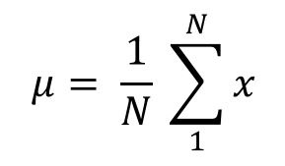
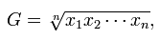
Central Location
(a) Arithmetic Mean
Of these “averages,” the most common and familiar is the arithmetic mean, defined by
(b) Geometric Mean
The geometric mean is defined as the nth root of the product of n observations:

Slide 9
Geometric Mean
For example, if a strain of bacteria increases its population by 20% in the first hour, 30% in the next hour and 50% in the next hour, we can find out an estimate of the mean percentage growth in population using Geometric mean.
Geometric mean of 2,3,and 6?
First, multiply the numbers together and then take the cubed root (because there are three numbers) = (2*3*6)1/3 = 3.30
geometric mean of 1/2, 1/4, 1/5, 9/72 and 7/4? First, multiply the numbers together and then take the 5th root: (1/2*1/4*1/5*9/72*7/4)^{(1/5)} = 0.35.

Slide 10
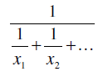
Central Location
(c) Harmonic Mean
The harmonic mean involves inverses—i.e., one divided by each of the quantities.
The harmonic mean is the inverse of the arithmetic mean of all the inverses.

Slide 11
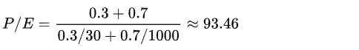
Harmonic Mean
Using the weighted harmonic mean (correct):
price–earnings ratio (P/E),

Slide 12
Harmonic Mean
You are a stock analyst in an investment bank. Your manager asked you to determine the P/E ratio of the index that tracks the stocks of Company A and Company B. Company A reports a market capitalization of $1 billion and earnings of $20 million while Company B reports a market capitalization of $20 billion and earnings of $5 billion. The index consists of 40% of Company A and 60% Company B.
Firstly, we need to find the P/E ratios of each company. Remember that the P/E ratio is essentially the market capitalization divided by the earnings.

Slide 13
Harmonic Mean
P/E (Company A) = ($1 billion) / ($20 million) = 50 P/E (Company B) = ($20 billion) / ($5 billion) = 4
We must use the weighted harmonic mean to calculate the P/E ratio of the index. Using the formula for the weighted harmonic mean, the P/E ratio of the index can be found in the following way:
P/E (Index) = (0.4+0.6) / (0.4/50 + 0.6/4) = 6.33
Note that if we calculate the P/E ratio of the index using the weighted arithmetic mean, it would be significantly overstated:
P/E (Index) = 0.4×50 + 0.6×4 = 22.4

Slide 14
Median
If all the items with which we are concerned are sorted in order of increasing magnitude (size), from the smallest to the largest, then the median is the middle item.
Consider the five items: 12, 13, 21, 27, 31. Then 21 is the median.
If the number of items is even, the median is given by the arithmetic mean of the two middle items. Consider the six items: 12, 13, 21, 27, 31, 33.
The median is (21 + 27) / 2 = 24.

Slide 15
Mode
If the frequency varies from one item to another, the mode is the value which appears most frequently.
In the case of continuous variables the frequency depends upon how many digits are quoted, so the mode is more usefully considered as the midpoint of the class with the largest frequency.

Slide 16
Grouped Mean, Median and Mode
You grew fifty baby carrots using special soil. You dig them up and measure their lengths (to the nearest mm) and group the results:
Length (mm) | Midpoint x | Frequency f | fx
150 - 154 | 152 | 5 | 760
155 - 159 | 157 | 2 | 314
160 - 164 | 162 | 6 | 972
165 - 169 | 167 | 8 | 1336
170 - 174 | 172 | 9 | 1548
175 - 179 | 177 | 11 | 1947
180 - 184 | 182 | 6 | 1092
185 - 189 | 187 | 3 | 561
 | Totals: | 50 | 8530
Length (mm) | Frequency
150 - 154 | 5
155 - 159 | 2
160 - 164 | 6
165 - 169 | 8
170 - 174 | 9
175 - 179 | 11
180 - 184 | 6
185 - 189 | 3
Estimated Mean = 853050 = 170.6 mm

Slide 17
Grouped Mean, Median and Mode
Median
The Median is the mean of the 25th and the 26th length, so is in the 170 - 174 group:
L = 169.5 (the lower class boundary of the 170 - 174 group) –> (167+172)/2
n = 50
B = 5 + 2 + 6 + 8 = 21
G = 9 → frequency
w = 5 -> Group width(150-154)
Estimated Median= 169.5 + (50/2) − 219 × 5
= 169.5 + 2.22...
= 171.7 mm (to 1 decimal)

Slide 18
Grouped Mean, Median and Mode
Mode
The Modal group is the one with the highest frequency, which is 175 - 179:
L = 174.5 (the lower class boundary of the 175 - 179 group)
f_{m-1} = 9
f_{m} = 11
f_{m+1} = 6
w = 5
Estimated Mode= 174.5 + 11 − 9(11 − 9) + (11 − 6) × 5
= 174.5 + 1.42...
= 175.9 mm (to 1 decimal)

Slide 19
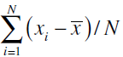
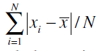
Variability or Spread of the Data
Mean Deviation from the Mean
The mean deviation from the mean, defined as –
Mean Absolute Deviation from the Mean

Slide 20
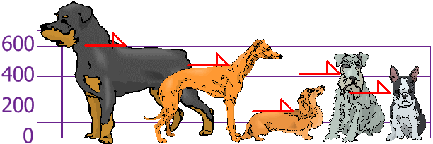
Mean Absolute Deviation
Example: You and your friends have just measured the heights of your dogs (in millimeters):
The heights (at the shoulders) are: 600mm, 470mm, 170mm, 430mm and 300mm.

Slide 21
Mean Absolute Deviation
Step 1: Find the mean:
μ = 600 + 470 + 170 + 430 + 3005 = 19705 = 394
Step 2: Find the Absolute Deviations:
x | |x - μ|
600 | 206
470 | 76
170 | 224
430 | 36
300 | 94
 | Σ|x - μ| = 636
Step 3. Find the Mean Deviation:
Mean Deviation = Σ|x - μ|N = 636/5 = 127.2
So, on average, the dogs' heights are 127.2 mm from the mean.

Slide 22
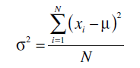
Variability or Spread of the Data
Variance
Since squares of both positive and negative real numbers are always positive, the variance is always positive.

Slide 23
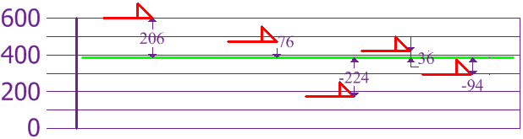
Variability or Spread of the Data
Variance
To calculate the Variance, take each difference, square it, and then average the result:
Variance
σ² | = | (206² + 76² + (−224)² + 36² + (−94)²) / 5
 | = | (42436 + 5776 + 50176 + 1296 + 8836)/5
 | = | 108520/5
 | = | 21704
So the Variance is 21,704

Slide 24
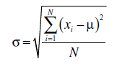
Variability or Spread of the Data
Standard Deviation

Slide 25
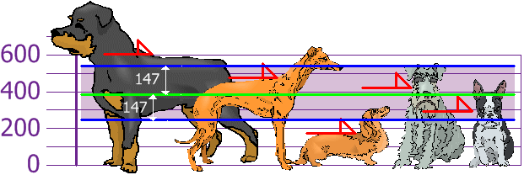
Variability or Spread of the Data
Standard Deviation
And the Standard Deviation is just the square root of Variance, so:
Standard Deviation
σ | = | √21704
 | = | 147.32...
 | = | 147 (to the nearest mm)

Slide 26
Multi Dimensional Array
Create a multidimensional array as follows:
In: m = array([arange(2), arange(2)])
In: m
Out:
array([[0, 1],
[0, 1]])
Show the array shape as follows:
In: m.shape
Out: (2, 2)

Slide 27
NumPy numerical types

Slide 28
NumPy numerical types

Slide 29
NumPy numerical types

Slide 30
Manipulating array shapes
Flattening is transforming a multidimensional array into a one-dimensional array.

Slide 31
Quartiles, Deciles, Percentiles, and Quantiles
Quartiles, deciles, and percentiles divide a frequency distribution into a number of parts containing equal frequencies.
Quartiles divide the range of values into four parts, each containing one quarter of the values.
Percentiles divide into a hundred parts, each containing one hundredth of the total frequency.
Quantile divides a frequency distribution into parts containing stated proportions of a distribution.

Slide 32
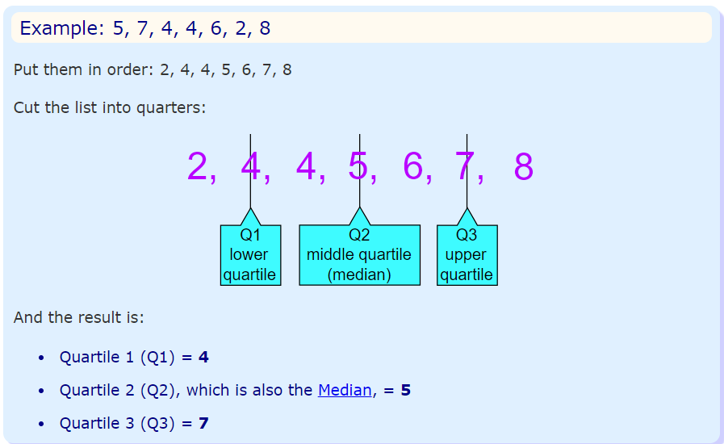
Quartiles
Quartiles are the values that divide a list of numbers into quarters:
Put the list of numbers in order
Then cut the list into four equal parts
The Quartiles are at the "cuts“

Slide 33
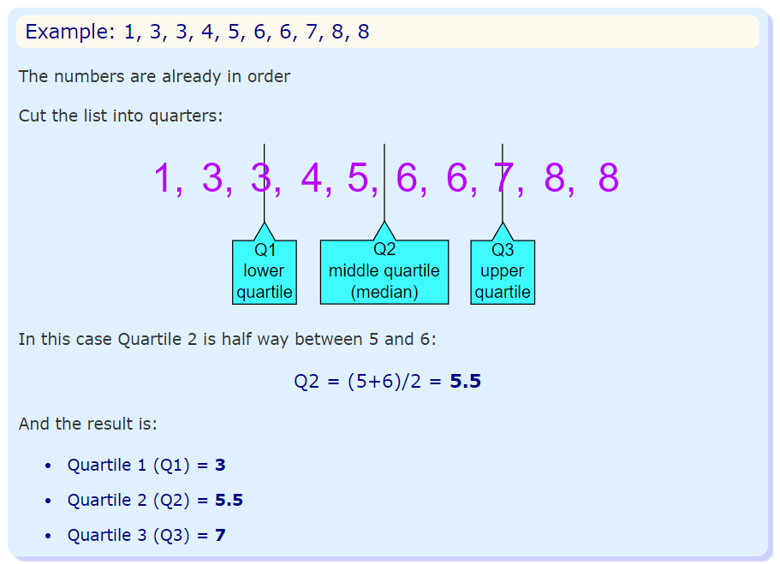
Quartiles

Slide 34
Decile
What is a Decile used for in Real Life?
Deciles and decile ranks are used more often in real life than in the classroom. For example, Australia uses decile ranks to report drought data. Deciles 1-2 represent the lowest 20% (“much below normal”). That means droughts that are “much below normal” don’t occur more than 20% of the time.
Deciles are also commonly used for college admissions and high school rankings. For example, this chart from Roanoke College shows the high school decile rankings for the student body.

Slide 35
Decile
Decile Rank | Percentile
1 | 10th
2 | 20th
3 | 30th
4 | 40th
5 | 50th
6 | 60th
7 | 70th
8 | 80th
9 | 90th

Slide 36
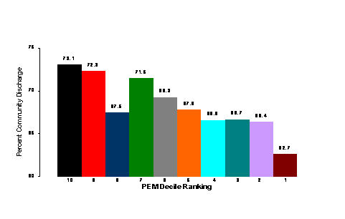
Decile

Slide 37
Normal Distribution
A normal distribution, sometimes called the bell curve, is a distribution that occurs naturally in many situations.
For example, the bell curve is seen in tests like the SAT and GRE.
The bulk of students will score the average (C), while smaller numbers of students will score a B or D.
An even smaller percentage of students score an F or an A.
This creates a distribution that resembles a bell (hence the nickname).
The bell curve is symmetrical. Half of the data will fall to the left of the mean; half will fall to the right.

Slide 38
Normal Distribution
Many groups follow this type of pattern. That’s why it’s widely used in business, statistics and in government bodies like the FDA:
Heights of people.
Measurement errors.
Blood pressure.
Points on a test.
IQ scores.
Salaries.

Slide 39
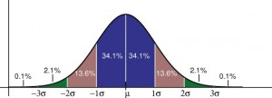
Normal Distribution
The empirical rule tells you what percentage of your data falls within a certain number of standard deviations from the mean: • 68% of the data falls within one standard deviation of the mean. • 95% of the data falls within two standard deviations of the mean. • 99.7% of the data falls within three standard deviations of the mean.

Slide 40
Normal Distribution
The standard deviation controls the spread of the distribution.
A smaller standard deviation indicates that the data is tightly clustered around the mean; the normal distribution will be taller.
A larger standard deviation indicates that the data is spread out around the mean; the normal distribution will be flatter and wider.

Slide 41
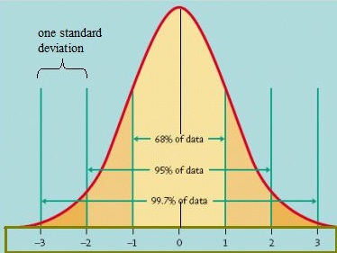
Standard Normal Model

Slide 42
Normal Distribution
Properties of a normal distribution
The mean, mode and median are all equal.
The curve is symmetric at the center (i.e. around the mean, μ).
Exactly half of the values are to the left of center and exactly half the values are to the right.
The total area under the curve is 1.

Slide 43
Word problems with normal distribution: “Between”: Steps
Step 1: Identify the parts of the word problem. The word problem will identify:
The mean (average or μ).
Standard deviation (σ).
Number selected (i.e. “choose one at random” or “select ten at random”).
X: the numbers associated with “between” (i.e. “between $5,000 and $10,000” would have X as 5,000 and as $10,000).

Slide 44
Word problems with normal distribution: “Between”: Steps
Step 1: Identify the parts of the word problem. The word problem will identify:
The mean (average or μ).
Standard deviation (σ).
Number selected (i.e. “choose one at random” or “select ten at random”).
X: the numbers associated with “between” (i.e. “between $5,000 and $10,000” would have X as 5,000 and as $10,000).

Slide 45
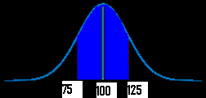
Word problems with normal distribution: “Between”: Steps
Step 2: Draw a graph. Put the mean you identified in Step 1 in the center.
Put the number associated with “between” on the graph (take a guess at where the numbers would fall–it doesn’t have to be exact).
For example, if your mean was $100, and you were asked for “hourly wages between $75 and $125”) your graph will look something like this:

Slide 46
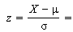
Word problems with normal distribution: “Between”: Steps
Step 3:Figure out the z-scores.
Plug the first X value (in my graph above, it’s 75) into the z value formula and solve. The μ (the mean), is 100 from the sample graph. You can get these figures (including σ, the standard deviation) from your answers in step 1 :
z score formula
*Note: if the formula confuses you, all this formula is asking you to do is:
subtract the mean from X
divide by the standard deviation.

Slide 47
Word problems with normal distribution: “Between”: Steps
Step 4: Repeat step 3 for the second X.
Step 5: Take the numbers from step 3 and 4 and use them to find the area in the z-table.
Step 6a:
Convert the answer from step 5 into a percentage.
For example, 0.1293 is 12.93%.
That’s it–skip step 6b!
Step 6b
Multiply the sample size (found in step 1) by the z-value you found in step 4. For example, 0.300 * 100 = 30.
That’s it!

Slide 48
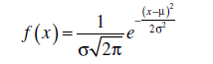
Normal Distribution
They are approximately symmetrical, and the mode is close to the centre of the distribution.
The mean, median, and mode are close together.
The shape of the distribution can be approximated by a bell: nearly flat on top, then decreasing more quickly, then decreasing more slowly toward the tails of the distribution.
This implies that values close to the mean are relatively frequent, and values farther from the mean tend to occur less frequently.
Probability Density Function

Slide 49
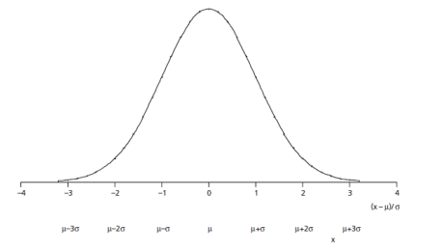
Normal Distribution

Slide 50
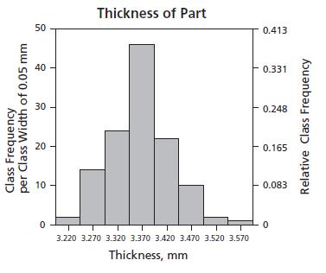
Normal Distribution

Slide 51
Normal Distribution
A survey of daily travel time had these results (in minutes):
26, 33, 65, 28, 34, 55, 25, 44, 50, 36, 26, 37, 43, 62, 35, 38, 45, 32, 28, 34
The Mean is 38.8 minutes, and the Standard Deviation is 11.4 minutes
To convert 26:
first subtract the mean: 26 - 38.8 = -12.8,
then divide by the Standard Deviation: -12.8/11.4 = -1.12
So 26 is -1.12 Standard Deviations from the Mean

Slide 52
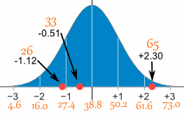
Normal Distribution
Here are the first three conversions
Original Value | Calculation | Standard Score (z-score)
26 | (26-38.8) / 11.4 = | -1.12
33 | (33-38.8) / 11.4 = | -0.51
65 | (65-38.8) / 11.4 = | +2.30
... | ... | ...

Slide 53
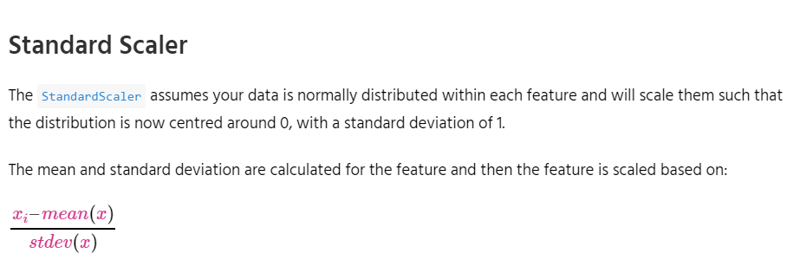
Feature Scaling
StandardScaler
MinMaxScaler
RobustScaler
Normalizer

Slide 54
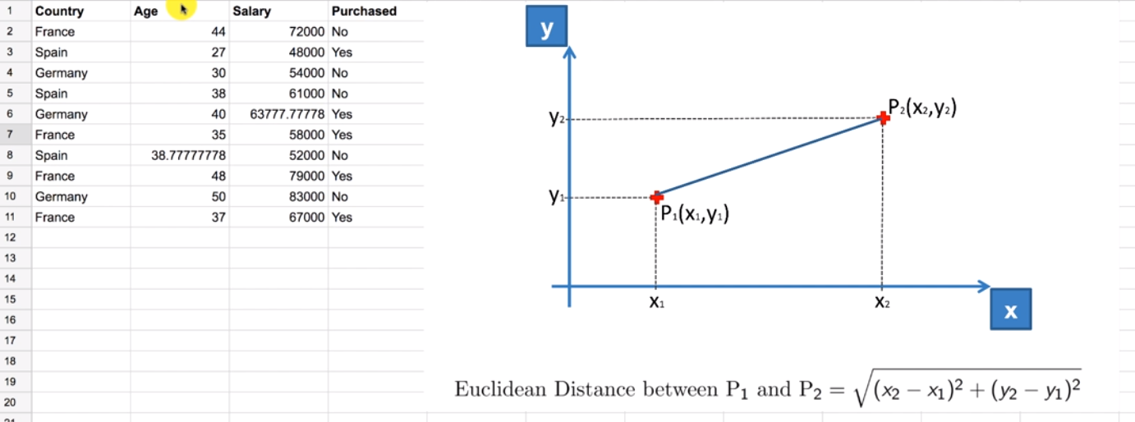

Slide 55
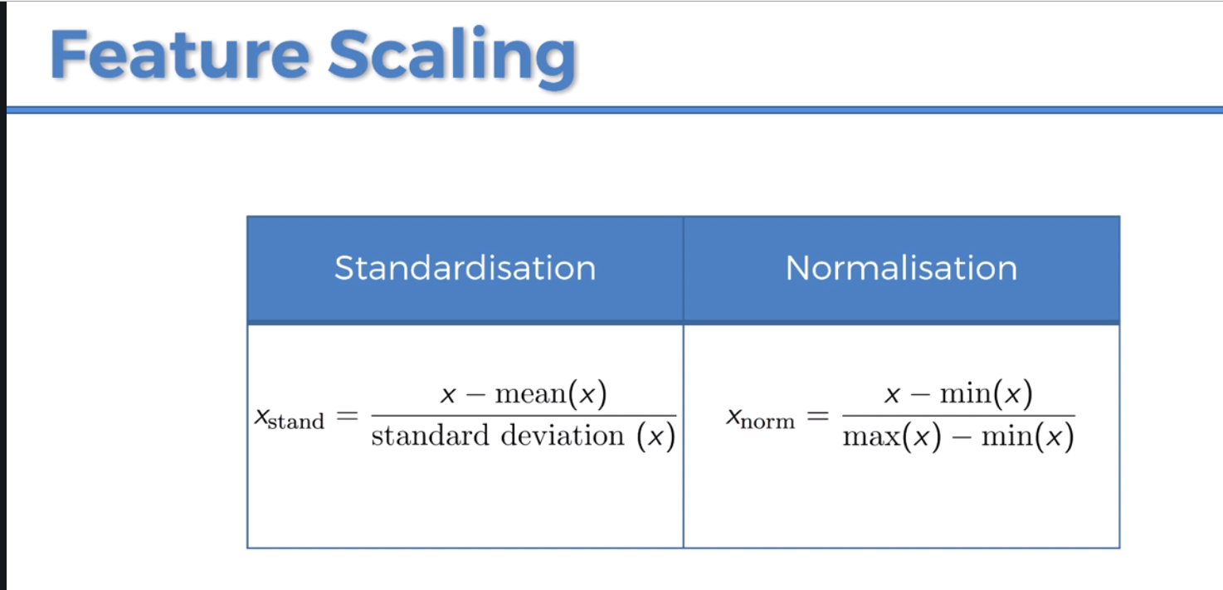

Slide 56
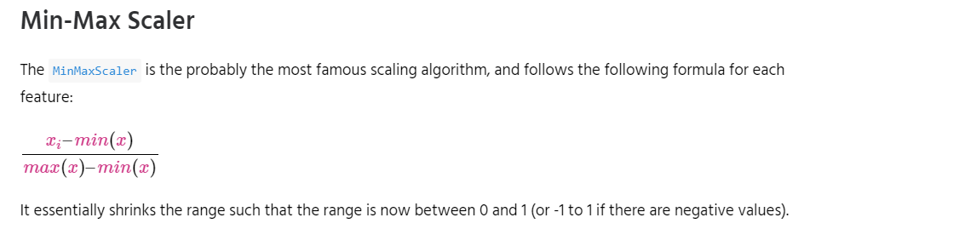
Feature Scaling
StandardScaler
MinMaxScaler
RobustScaler
Normalizer

Slide 57
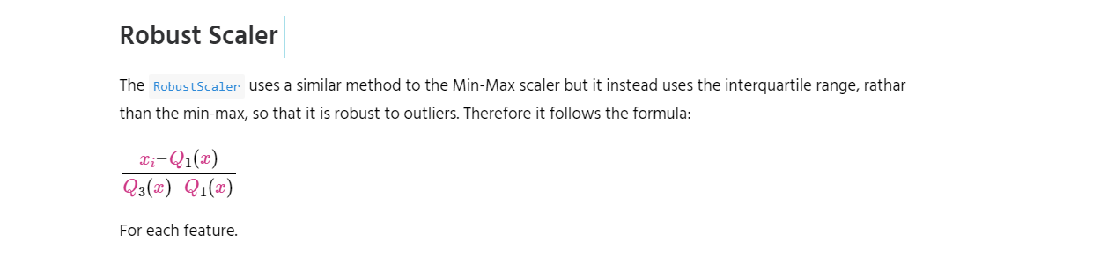
Feature Scaling

Slide 58
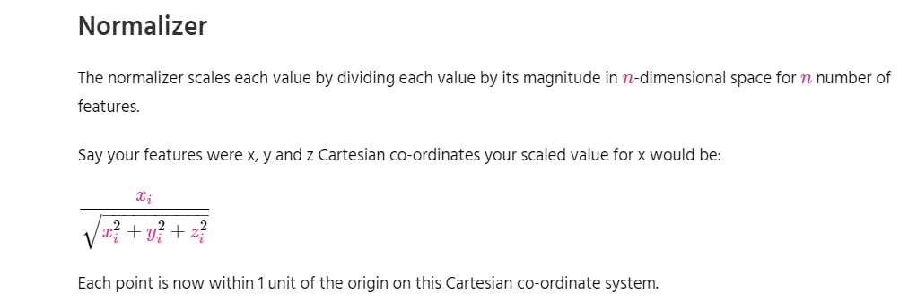
Feature Scaling

Slide 59
Simple Linear Regression
Simple linear regression is a statistical method that allows us to summarize and study relationships between two continuous (quantitative) variables:
One variable, denoted x, is regarded as the predictor, explanatory, or independent variable.
The other variable, denoted y, is regarded as the response, outcome, or dependent variable.

Slide 60
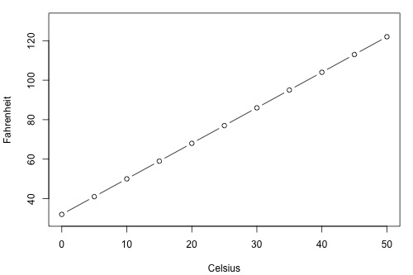
Simple Linear Regression

Slide 61
Types of Relationships
Deterministic
Temperature conversion
Circumference = π × diameter
Hooke's Law: Y = α + βX, where Y = amount of stretch in a spring, and X = applied weight.
Ohm's Law: I = V/r, where V = voltage applied, r = resistance, and I = current.
Boyle's Law: For a constant temperature, P = α/V, where P = pressure, α = constant for each gas, and V = volume of gas.

Slide 62
Types of Relationships
Statistical
Height and weight — as height increases, you'd expect weight to increase, but not perfectly.
Alcohol consumed and blood alcohol content — as alcohol consumption increases, you'd expect one's blood alcohol content to increase, but not perfectly.
Vital lung capacity and pack-years of smoking — as amount of smoking increases (as quantified by the number of pack-years of smoking), you'd expect lung function (as quantified by vital lung capacity) to decrease, but not perfectly.
Driving speed and gas mileage — as driving speed increases, you'd expect gas mileage to decrease, but not perfectly.

Slide 63
Real Time Example
We have a dataset which contains information about relationship between ‘number of hours studied’ and ‘marks obtained’.
Many students have been observed and their hours of study and grade are recorded.
This will be our training data. Goal is to design a model that can predict marks if given the number of hours studied.
Using the training data, a regression line is obtained which will give minimum error.
This linear equation is then used for any new data.
That is, if we give number of hours studied by a student as an input, our model should predict their mark with minimum error.

Slide 64
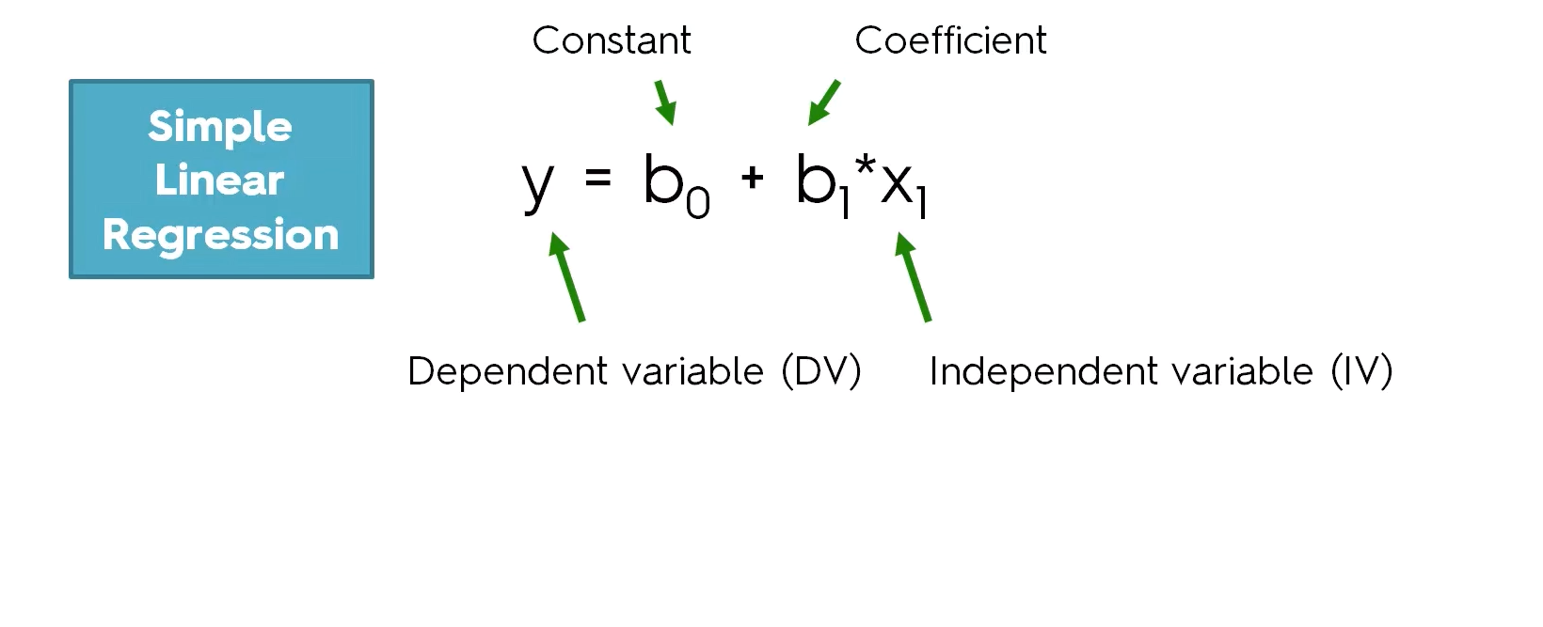

Slide 65
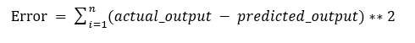
Simple Linear Regression
The values b0 and b1 must be chosen so that they minimize the error.
If sum of squared error is taken as a metric to evaluate the model, then goal to obtain a line that best reduces the error.
If we don’t square the error, then positive and negative point will cancel out each other.

Slide 66
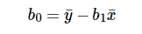
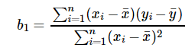
Simple Linear Regression
For model with one predictor,

Slide 67
Simple Linear Regression
Exploring ‘b1’
If b1 > 0, then x(predictor) and y(target) have a positive relationship. That is increase in x will increase y.
If b1 < 0, then x(predictor) and y(target) have a negative relationship. That is increase in x will decrease y.

Slide 68
Simple Linear Regression
Exploring ‘b0’
If the model does not include x=0, then the prediction will become meaningless with only b0. For example, we have a dataset that relates height(x) and weight(y). Taking x=0(that is height as 0), will make equation have only b0 value which is completely meaningless as in real-time height and weight can never be zero. This resulted due to considering the model values beyond its scope.
If the model includes value 0, then ‘b0’ will be the average of all predicted values when x=0. But, setting zero for all the predictor variables is often impossible.
The value of b0 guarantee that residual have mean zero. If there is no ‘b0’ term, then regression will be forced to pass over the origin. Both the regression co-efficient and prediction will be biased.

Slide 69
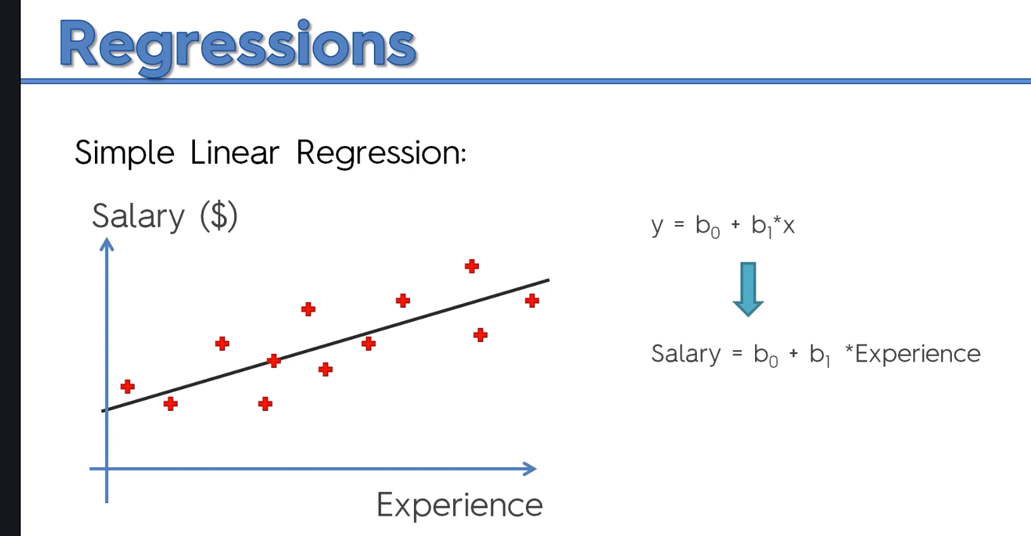

Slide 70
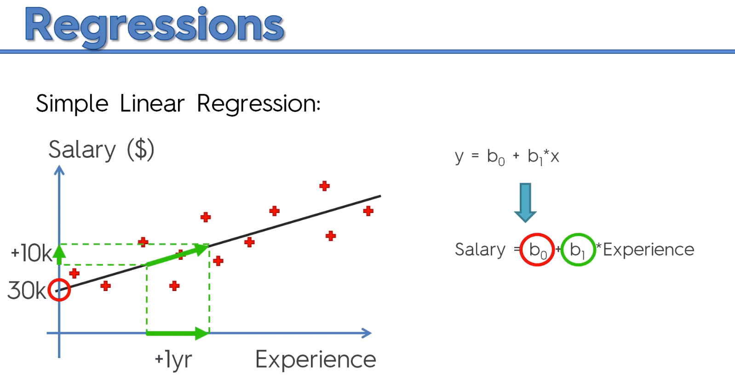

Slide 71
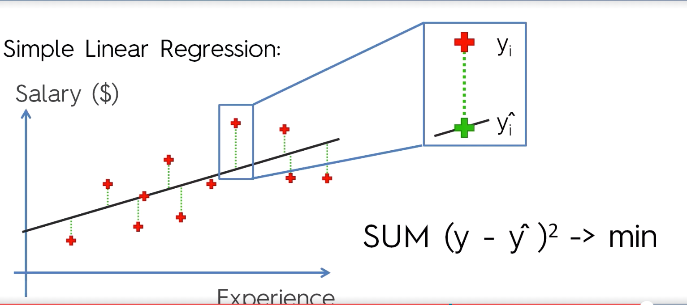
Ordinary Least Square Method

Slide 72
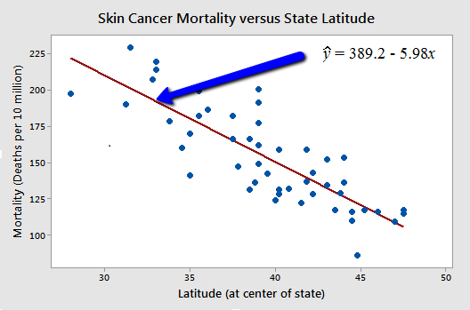
Types of Relationships

Slide 73
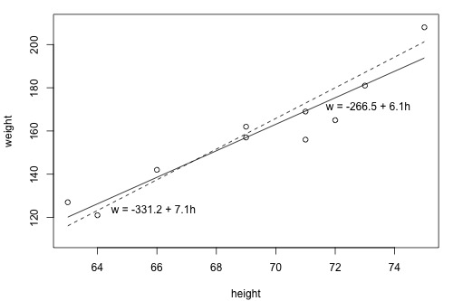
What is the "Best Fitting Line"?

Slide 74
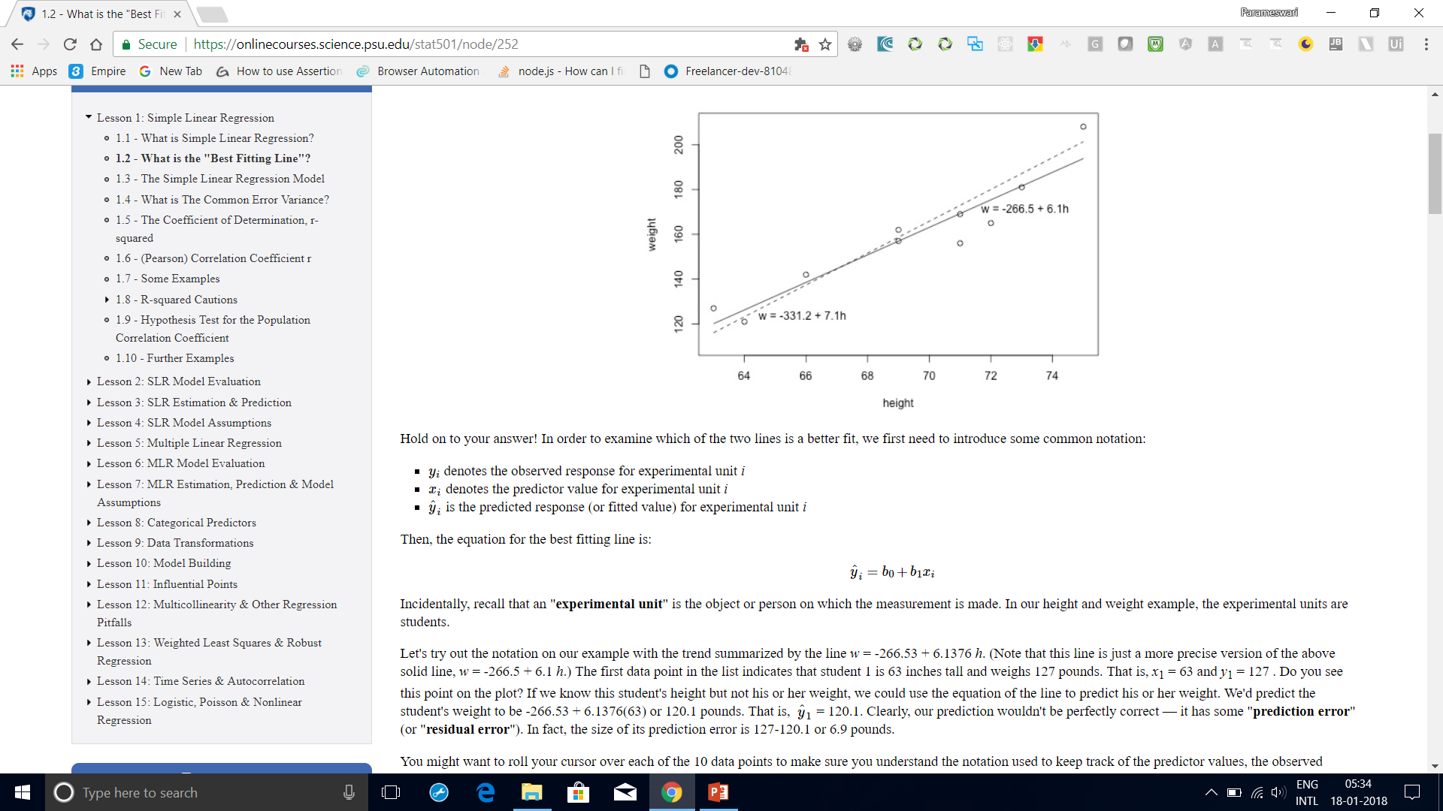
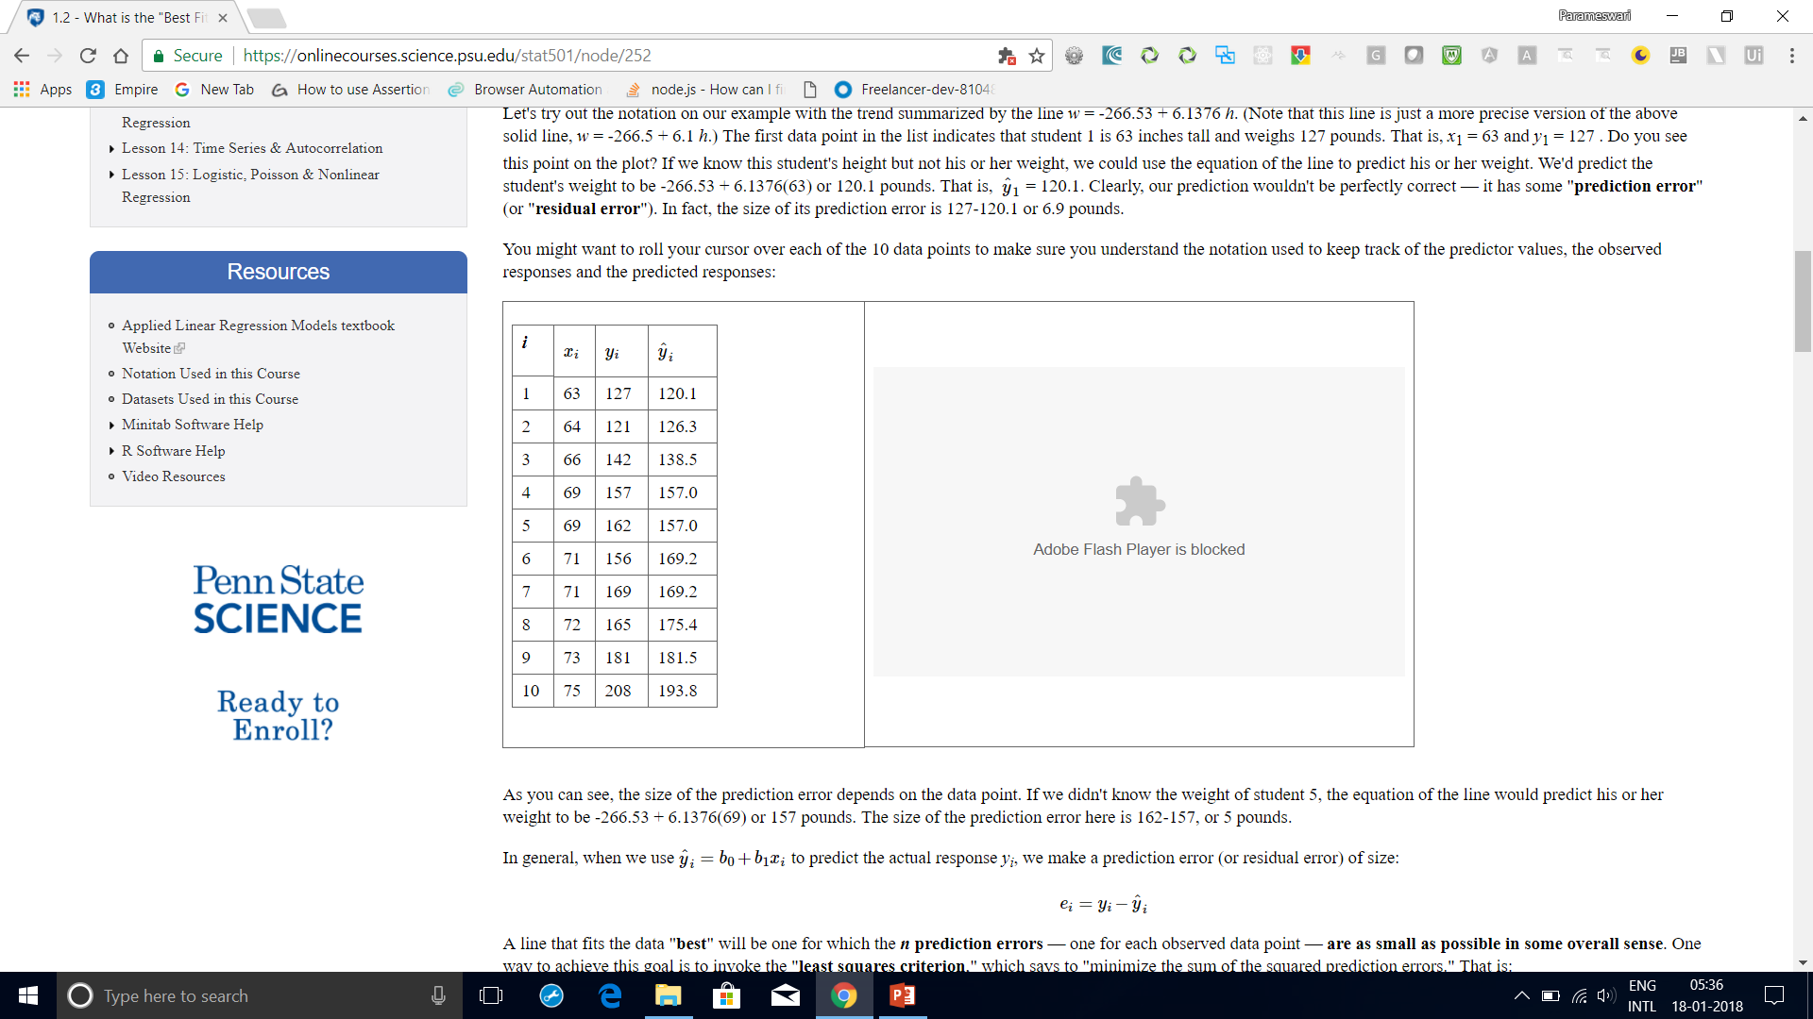
What is the "Best Fitting Line"?
it has some "prediction error" (or "residual error").
In fact, the size of its prediction error is 127-120.1 or 6.9 pounds.
As you can see, the size of the prediction error depends on the data point.
If we didn't know the weight of student 5, the equation of the line would predict his or
her weight to be -266.53 + 6.1376(69) or 157 pounds.
The size of the prediction error here is 162-157, or 5 pounds.

Slide 75
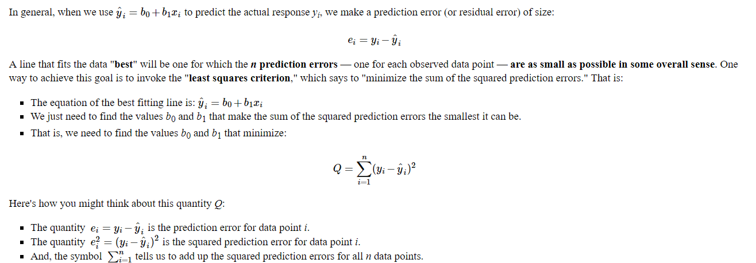
What is the "Best Fitting Line"?

Slide 76
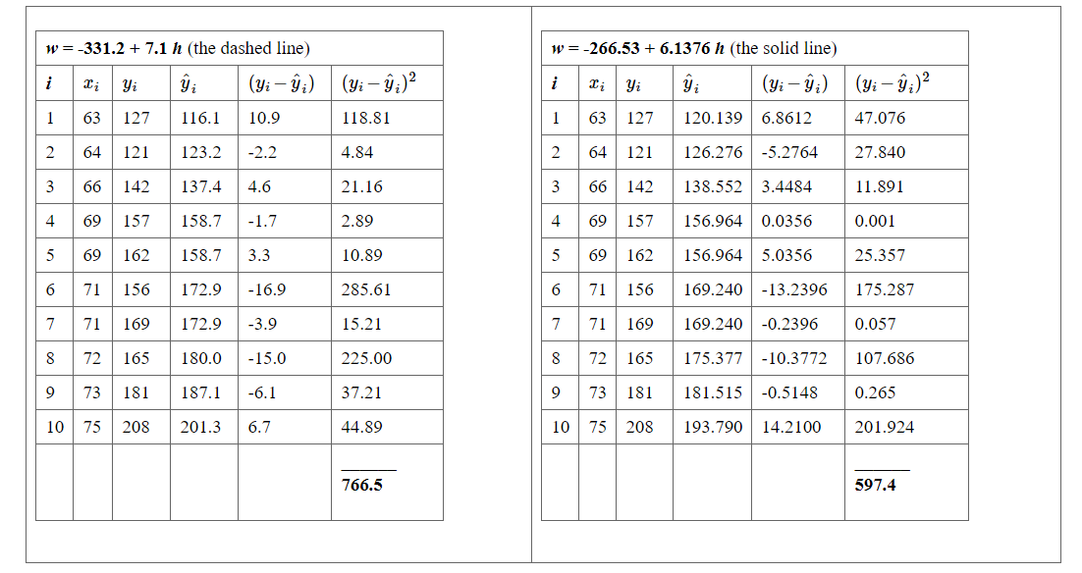
What is the "Best Fitting Line"?

Slide 77
What is the "Best Fitting Line"?
Based on the least squares criterion, which equation best summarizes the data?
The sum of the squared prediction errors is 766.5 for the dashed line, while it is only 597.4 for the solid line.
Therefore, of the two lines, the solid line, w = -266.53 + 6.1376h, best summarizes the data.

Slide 78
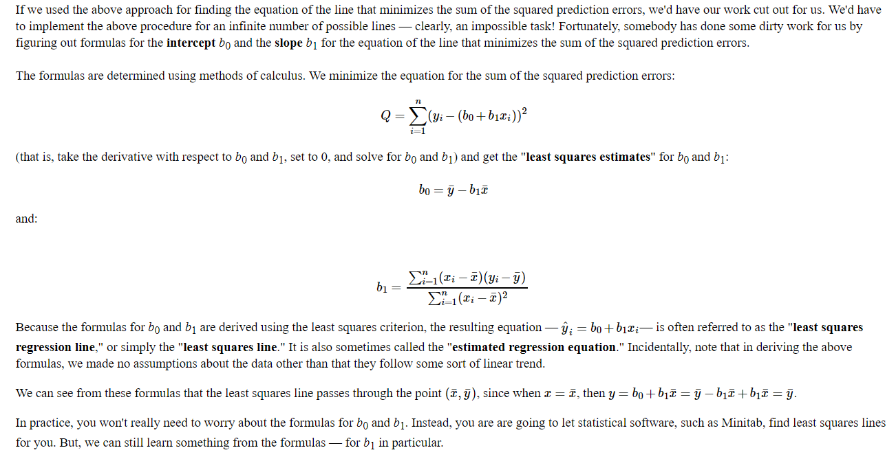
What is the "Best Fitting Line"?

Slide 79
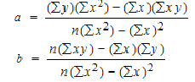
Slope and Intercept calculation

Slide 80
How to Find a Linear Regression Equation: Steps
Step 1: Make a chart of your data, filling in the columns in the same way as you would fill in the chart if you were finding the Pearson’s Correlation Coefficient.
SUBJECT | AGE X | GLUCOSE LEVEL Y | XY | X² | Y²
1 | 43 | 99 | 4257 | 1849 | 9801
2 | 21 | 65 | 1365 | 441 | 4225
3 | 25 | 79 | 1975 | 625 | 6241
4 | 42 | 75 | 3150 | 1764 | 5625
5 | 57 | 87 | 4959 | 3249 | 7569
6 | 59 | 81 | 4779 | 3481 | 6561
Σ | 247 | 486 | 20485 | 11409 | 40022
From the above table, Σx = 247, Σy = 486, Σxy = 20485, Σx2 = 11409, Σy2 = 40022. n is the sample size (6, in our case).

Slide 81
How to Find a Linear Regression Equation: Steps
Step 2: Use the following equations to find a and b.
a = 65.1416 b = .385225

Slide 82
How to Find a Linear Regression Equation: Steps
Step 2: Use the following equations to find a and b.
Find a:
((486 × 11,409) – ((247 × 20,485)) / 6 (11,409) – 247²)
484979 / 7445
=65.14
Find b:
(6(20,485) – (247 × 486)) / (6 (11409) – 247²)
(122,910 – 120,042) / 68,454 – 247²
2,868 / 7,445
= .385225

Slide 83
How to Find a Linear Regression Equation: Steps
Step 3: Insert the values into the equation. y’ = a + bx y’ = 65.14 + .385225x
That’s how to find a linear regression equation by hand!

Slide 84
Interpolation vs Regression
In the mathematical field of numerical analysis, interpolation is a method of constructing new data points within the range of a discrete set of known data points.
Interpolation is the process of deriving a simple function from a set of discrete data points so that the function passes through all the given data points (i.e. reproduces the data points exactly) and can be used to estimate data points in-between the given ones.
Newton method

Slide 85
Interpolation vs Regression
Regression is different from interpolation in that it allows us to approximate overdetermined system, which has more equations than unknowns.
This is useful when the exact solution is too expensive or unnecessary due to errors in the data, such as measurement errors or random noise.

Slide 86
Interpolation vs Regression
In interpolation you are given some data points, and you are supposed to find a curve which fits the input/output relationship perfectly. In case of interpolation, you don't have to worry about variance of the fitted curve. As long as your curve is giving perfect output(for a given dataset), you are done.
In regression, your curve should not be over-fitting. It should give you a regularized model so that you can predict future values. Variance of your function should be as low as possible. Your model should be generalized so that you can accurately predict future values.

Slide 87
Interpolation vs Regression
Interpolation is like an algorithm without a "brain": it tries to achieve perfect match to the given data
Regression is the same algorithm with the power to generalize. It won't fit perfectly to your data but at least it will try to learn some insights from it.

Slide 92
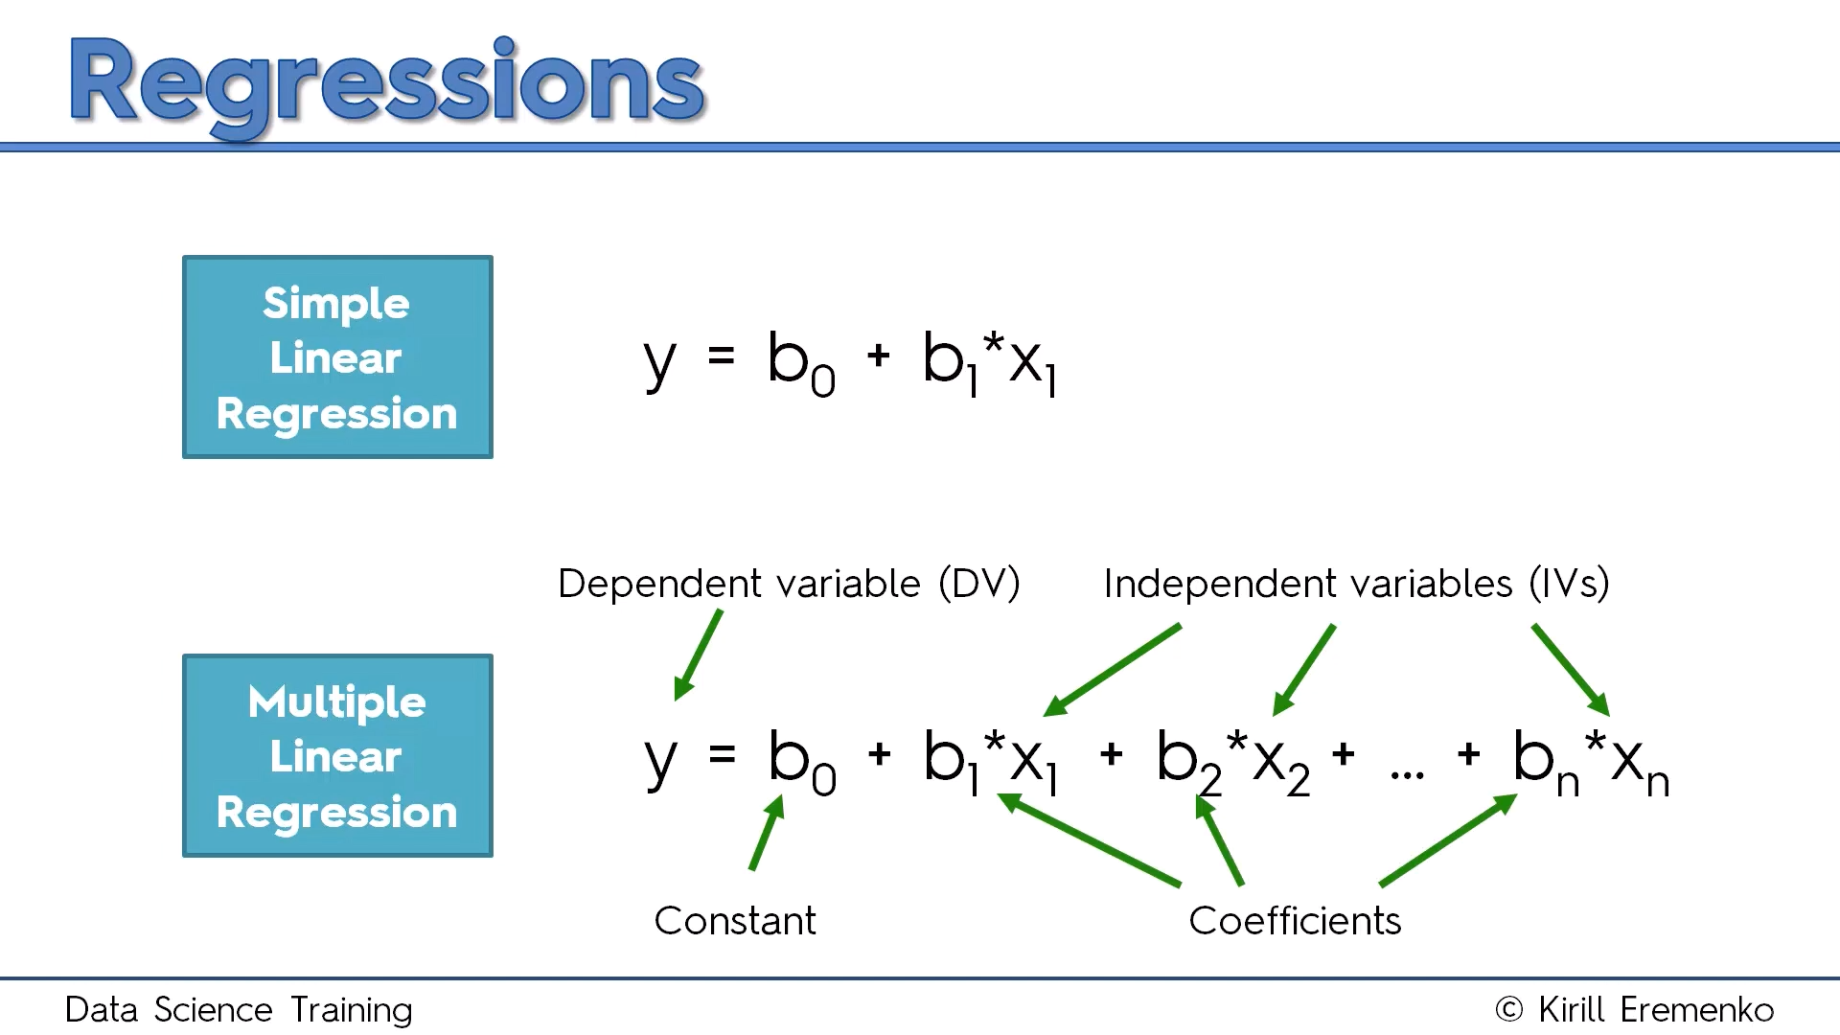
Multiple Linear Regression

Slide 93
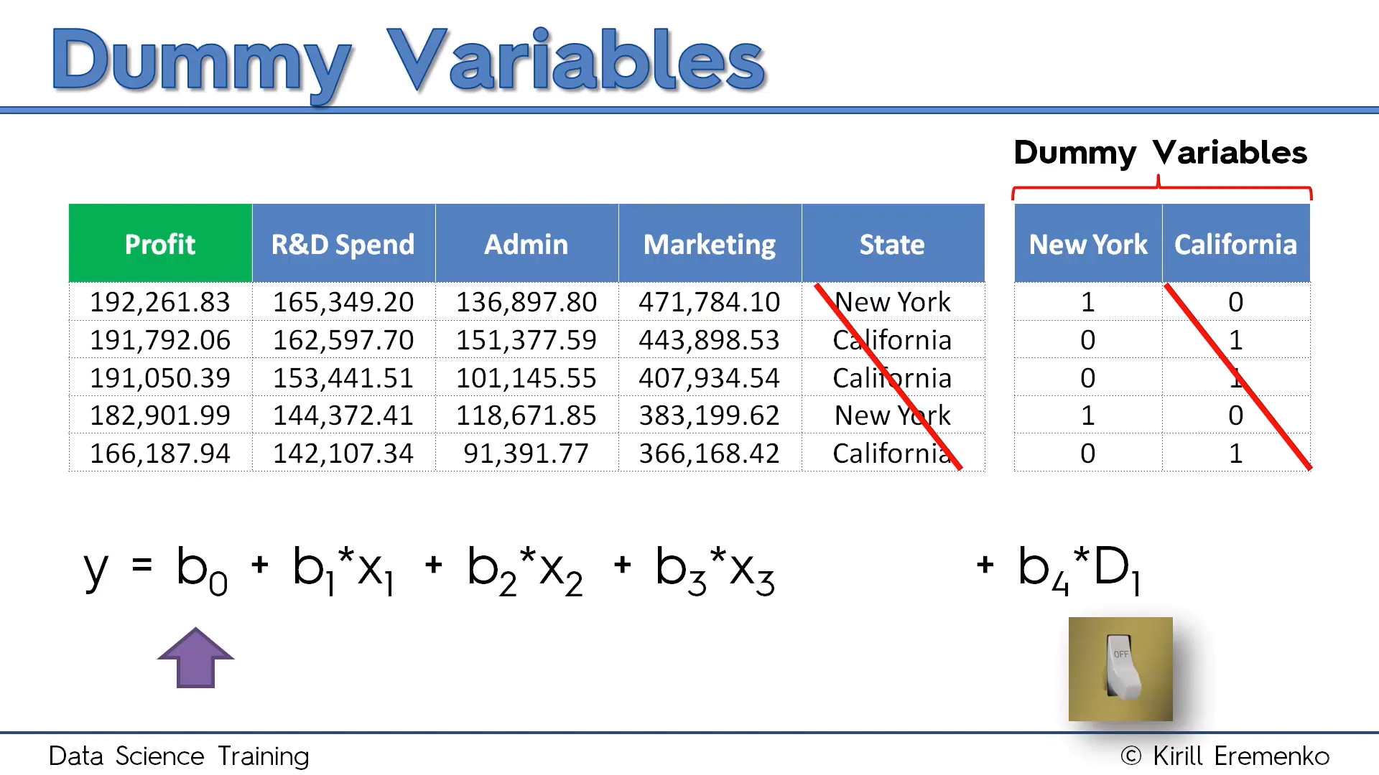

Slide 94
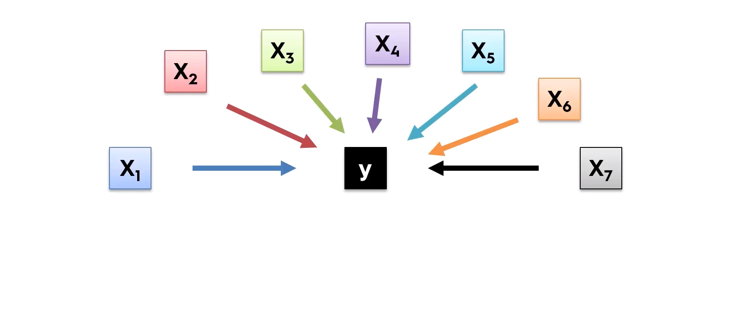
Building Model

Slide 95
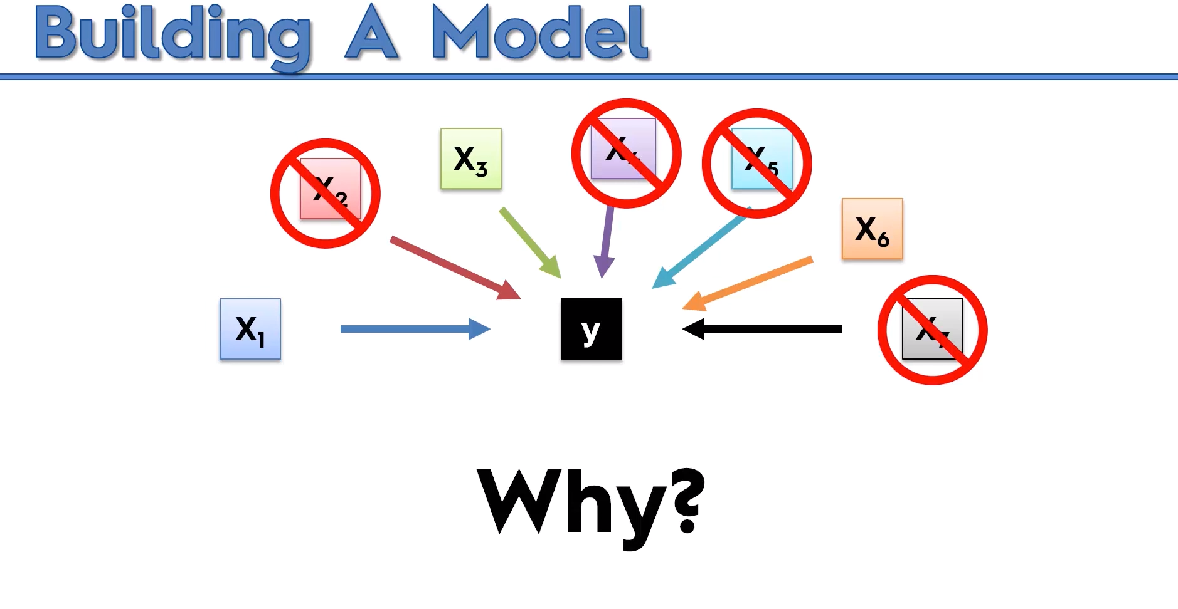

Slide 96


Slide 97


Slide 98


Slide 99


Slide 100


Slide 101


Slide 102


Slide 103
import statsmodels.formula.api as sm
def backwardElimination(x, sl):
numVars = len(x[0])
for i in range(0, numVars):
regressor_OLS = sm.OLS(y, x).fit()
maxVar = max(regressor_OLS.pvalues).astype(float)
if maxVar > sl:
for j in range(0, numVars - i):
if (regressor_OLS.pvalues[j].astype(float) == maxVar):
x = np.delete(x, j, 1)
regressor_OLS.summary()
return x
SL = 0.05
X_opt = X[:, [0, 1, 2, 3, 4, 5]]
X_Modeled = backwardElimination(X_opt, SL)

Slide 104


Slide 105


Slide 106


Slide 107


Slide 108


Slide 109


Slide 110


Slide 111

Ordinary Least Square Method

Slide 112

We can drop few variables and select only those that have p values < 0.5 and then we can check improvement in the model.
A general approach to compare two different models is AIC( Akaike Information Criteria) and the model with minimum AIC is the best one.

Slide 113
OLS Summary Interpretation
Omnibus/Prob(Omnibus) – a test of the skewness and kurtosis of the residual (characteristic #2). We hope to see a value close to zero which would indicate normalcy. The Prob (Omnibus) performs a statistical test indicating the probability that the residuals are normally distributed. We hope to see something close to 1 here. In this case Omnibus is relatively low and the Prob (Omnibus) is relatively high so the data is somewhat normal, but not altogether ideal. A linear regression approach would probably be better than random guessing but likely not as good as a nonlinear approach.
Skew – a measure of data symmetry. We want to see something close to zero, indicating the residual distribution is normal. Note that this value also drives the Omnibus. This result has a small, and therefore good, skew.
Kurtosis – a measure of "peakiness", or curvature of the data. Higher peaks lead to greater Kurtosis. Greater Kurtosis can be interpreted as a tighter clustering of residuals around zero, implying a better model with few outliers.

Slide 114
OLS Summary Interpretation
Durbin-Watson – tests for homoscedasticity (characteristic #3). We hope to have a value between 1 and 2. In this case, the data is close, but within limits.
Jarque-Bera (JB)/Prob(JB) – like the Omnibus test in that it tests both skew and kurtosis. We hope to see in this test a confirmation of the Omnibus test. In this case we do.
Condition Number – This test measures the sensitivity of a function's output as compared to its input (characteristic #4). When we have multicollinearity, we can expect much higher fluctuations to small changes in the data, hence, we hope to see a relatively small number, something below 30. In this case we are well below 30, which we would expect given our model only has two variables and one is a constant.

Slide 115
OLS Summary Interpretation
he AIC or BIC for a model is usually written in the form [-2logL + kp], where L is the likelihood function, p is the number of parameters in the model, and k is 2 for AIC and log(n) for BIC.
AIC is an estimate of a constant plus the relative distance between the unknown true likelihood function of the data and the fitted likelihood function of the model, so that a lower AIC means a model is considered to be closer to the truth.
BIC is an estimate of a function of the posterior probability of a model being true, under a certain Bayesian setup, so that a lower BIC means that a model is considered to be more likely to be the true model.

Slide 116


Slide 117


Slide 118
Support Vector Regression
SVM is a supervised learning model
Problem:
I have a business and I receive a lot of emails from customers every day. Some of these emails are complaints and should be answered very quickly. I would like a way to identify them quickly so that I answer these email in priority.

Slide 119
Support Vector Regression
Approach: I can use a supervised machine learning algorithm.
Step 1: I need a lot of emails, the more the better. Step 2: I will read the title of each email and classify it by saying "it is a complaint" or "it is not a complaint". It put a label on each email. Step 3: I will train a model on this dataset Step 4: I will assess the quality of the prediction (using cross validation) Step 5: I will use this model to predict if an email is a complaint or not.
In this case, if I have trained the model with a lot of emails then it will perform well. SVM is just one among many models you can use to learn from this data and make predictions.

Slide 120
Support Vector Regression
SVMs - Support Vector Machines
Wikipedia tells us that SVMs can be used to do two things: classification or regression.
SVM is used for classification
SVR (Support Vector Regression) is used for regression

Slide 121
What is the goal of the Support Vector Machine (SVM)?
The goal of a support vector machine is to find the optimal separating hyperplane which maximizes the margin of the training data.
The first thing we can see from this definition, is that a SVM needs training data. Which means it is a supervised learning algorithm.
It is also important to know that SVM is a classification algorithm. Which means we will use it to predict if something belongs to a particular class.

Slide 122


Slide 123
SVM
We have plotted the size and weight of several people, and there is also a way to distinguish between men and women.
With such data, using a SVM will allow us to answer the following question:
Given a particular data point (weight and size), is the person a man or a woman ?
For instance: if someone measures 175 cm and weights 80 kg, is it a man of a woman?

Slide 124

For a second, pretend you own a farm and you have a problem–you need to set up a fence to protect your rabbits from a pack of wolves. But where do you build your fence?

Slide 125

Hyperplane between any two classes in order to separate them or classify them

Slide 126

What is a Support Vector in SVM?
So, you start of by drawing a random hyperplane and then you check the distance between the hyperplane and the closest data points from each class. These closest data points to the hyperplane are known as support vectors. And that’s where the name comes from, support vector machine.

Slide 127

The hyperplane is drawn based on these support vectors and an optimum hyperplane will have a maximum distance from each of the support vectors.
And this distance between the hyperplane and the support vectors is known as the margin.
To sum it up, SVM is used to classify data by using a hyperplane, such that the distance between the hyperplane and the support vectors is maximum.
Let’s say that I input a new data point and now I want to draw a hyperplane such that it best separates these two classes.

Slide 128

So, I start off by drawing a hyperplane and then I check the distance between the hyperplane and the support vectors. Here I’m basically trying to check if the margin is maximum for this hyperplane.

Slide 129

But what if I draw the hyperplane like this? The margin for this hyperplane is clearly more than the previous one. So, this is my optimal hyperplane.
So far it was quite easy, our data was linearly separable, which means that you could a draw a straight line to separate the two classes!

Slide 130

But what will you do if the data set is like this?

Slide 131

You possibly can’t draw a hyperplane like this! It doesn’t separate the two classes.

Slide 132
Non-Linear Support Vector Machine (SVM)
Kernel functions offer the user the option of transforming nonlinear spaces into linear ones.
Until this point, we were plotting our data on 2-dimensional space. So, we had only 2 variables, x and y.
A simple trick would be transforming the two variables x and y into a new feature space involving a new variable z. Basically, we’re visualizing the data on a 3-dimensional space.
When you transform the 2D space into a 3D space you can clearly see a dividing margin between the 2 classes of data. And now you can go ahead and separate the two classes by drawing the best hyperplane between them.

Slide 133


Slide 134

What is a separating hyperplane?
For instance, we could trace a line and then all the data points representing men will be above the line, and all the data points representing women will be below the line.
Such a line is called a separating hyperplane and is depicted below:

Slide 135
If it is just a line, why do we call it an hyperplane ?
An hyperplane is a generalization of a plane.
in one dimension, an hyperplane is called a point
in two dimensions, it is a line
in three dimensions, it is a plane
in more dimensions you can call it an hyperplane

Slide 136

What is the optimal separating hyperplane?
The fact that you can find a separating hyperplane, does not mean it is the best one !
In the example below there is several separating hyperplanes. Each of them is valid as it successfully separates our data set with men on one side and women on the other side.

Slide 137

Optimal Hyperplane
The black hyperplane classifies more accurately than the green one

Slide 138

What is the margin and how does it help choosing the optimal hyperplane?
Given a particular hyperplane, we can compute the distance between the hyperplane and the closest data point.
Once we have this value, if we double it we will get what is called the margin.
Basically the margin is a no man's land. There will never be any data point inside the margin.

Slide 139
Optimal Hyperplane
We can make the following observations:
If an hyperplane is very close to a data point, its margin will be small.
The further an hyperplane is from a data point, the larger its margin will be.
This means that the optimal hyperplane will be the one with the biggest margin.

Slide 140

Data Points

Slide 141

Linear Fit

Slide 142
Linear Fit
rmse <- function(error)
{
sqrt(mean(error^2))
}
error <- model$residuals # same as data$Y - predictedY
predictionRMSE <- rmse(error) # 5.703778
How to Improve?

Slide 143

SVM Regression
# /!\ this time svrModel$residuals is not the same as data$Y - predictedY
# so we compute the error like this
error <- data$Y - predictedY
svrPredictionRMSE <- rmse(error) # 3.157061

Slide 144

Improved SVM with eps factor adjustment

Slide 145


What is a vector?
A vector is an object that has both a magnitude and a direction.
If we define a point A(3,4) in R2 we can plot it like this.
Definition: Any point x=(x1,x2),x≠0, in R2 specifies a vector in the plane, namely the vector starting at the origin and ending at x.
If we say that the point at the origin is the point O(0,0) then the vector above is the vector OA→. We could also give it an arbitrary name such as u.

Slide 146


The magnitude
The magnitude or length of a vector x is written ∥x∥ and is called its norm.
For our vector OA→, ∥OA∥ is the length of the segment OA

Slide 147

The direction
The direction is the second component of a vector.
Definition : The direction of a vector u(u1,u2) is the vector w(u1∥u∥,u2∥u∥)

Slide 148


Computing the direction vector
The direction of u(3,4) is the vector w(0.6,0.8)

Slide 149

The sum of two vectors

Slide 150

Third Vector

Slide 151

The difference between two vectors

Slide 152

The difference between two vectors

Slide 153

The dot product
Definition: Geometrically, it is the product of the Euclidian magnitudes of the two vectors and the cosine of the angle between them

Slide 154

We can see that
θ=β−α
So computing cos(θ) is like computing cos(β−α)
There is a special formula called the difference identity for cosine which says that:
cos(β−α)=cos(β)cos(α)+sin(β)sin(α)

Slide 155


Slide 156


Slide 157

The SVM hyperplane
Understanding the equation of the hyperplane
You probably learnt that an equation of a line is : y=ax+b. However when reading about hyperplane, you will often find that the equation of an hyperplane is defined by :

Slide 158
The SVM hyperplane
How does these two forms relate ?
In the hyperplane equation you can see that the name of the variables are in bold. Which means that they are vectors !
Moreover, wTx is how we compute the inner product of two vectors, and if you recall, the inner product is just another name for the dot product !

Slide 159

The SVM hyperplane

Slide 160

The SVM hyperplane
For two reasons:
it is easier to work in more than two dimensions with this notation,
the vector w will always be normal to the hyperplane.

Slide 161
SVM hyperplane
Our goal is to find the distance between the point A(3,4) and the hyperplane.
We start with two vectors, w=(2,1) which is normal to the hyperplane, and a=(3,4) which is the vector between the origin and A.

Slide 162


Slide 163

SVM Hyperplane
Compute the margin of the hyperplane
Now that we have the distance ∥p∥ between A and the hyperplane, the margin is defined by :

Slide 164

Optimal hyperplane

Slide 165
α
Maximum Margin
x
f
y^{est}
Maximizing the margin is good according to intuition and PAC theory
Implies that only support vectors are important; other training examples are ignorable.
Empirically it works very very well.
f(x,w,b) = sign(w x + b)
denotes +1
denotes -1
The maximum margin linear classifier is the linear classifier with the, um, maximum margin.
This is the simplest kind of SVM (Called an LSVM)
Support Vectors are those datapoints that the margin pushes up against
Linear SVM

Slide 166
Linear SVM Mathematically
x⁺
M=Margin Width
“Predict Class = +1” zone
X⁻
wx+b=1
“Predict Class = -1” zone
wx+b=0
wx+b=-1
What we know:
w . x⁺ + b = +1
w . x⁻ + b = -1
w . (x⁺-x⁻⁾ = 2

Slide 167
Linear SVM Mathematically
Goal: 1) Correctly classify all training data
if y_{i} = +1
if y_{i} = -1
for all i
2) Maximize the Margin
same as minimize
We can formulate a Quadratic Optimization Problem and solve for w and b
Minimize
subject to

Slide 168
Solving the Optimization Problem
Find w and b such that
Φ(w) =½ w^{T}w is minimized;
and for all {(x_{i} ,y_{i})}: y_{i} (w^{T}x_{i} + b) ≥ 1
Need to optimize a quadratic function subject to linear constraints.
Quadratic optimization problems are a well-known class of mathematical programming problems, and many (rather intricate) algorithms exist for solving them.
The solution involves constructing a dual problem where a Lagrange multiplier α_{i} is associated with every constraint in the primary problem:
Find α₁…α_{N} such that
Q(α) =Σα_{i} - ½ΣΣα_{i}α_{j}y_{i}y_{j}x_{i}^{T}x_{j} is maximized and
(1) Σα_{i}y_{i} = 0
(2) α_{i} ≥ 0 for all α_{i}

Slide 169
The Optimization Problem Solution
The solution has the form:
Each non-zero α_{i} indicates that corresponding x_{i} is a support vector.
Then the classifying function will have the form:
Notice that it relies on an inner product between the test point x and the support vectors x_{i} – we will return to this later.
Also keep in mind that solving the optimization problem involved computing the inner products x_{i}^{T}x_{j} between all pairs of training points.
w =Σα_{i}y_{i}x_{i} b= y_{k}- w^{T}x_{k} for any x_{k} such that α_{k}≠ 0
f(x) = Σα_{i}y_{i}x_{i}^{T}x + b

Slide 170
Dataset with noise
denotes +1
denotes -1
Hard Margin: So far we require all data points be classified correctly
- No training error
What if the training set is noisy?
- Solution 1: use very powerful kernels
OVERFITTING!

Slide 171
Soft Margin Classification
Slack variables ξi can be added to allow misclassification of difficult or noisy examples.
What should our quadratic optimization criterion be?
Minimize
ε₁₁
ε₂
wx+b=1
ε₇
wx+b=0
wx+b=-1

Slide 172
Hard Margin v.s. Soft Margin
The old formulation:
The new formulation incorporating slack variables:
Parameter C can be viewed as a way to control overfitting.
Find w and b such that
Φ(w) =½ w^{T}w is minimized and for all {(x_{i} ,y_{i})}
y_{i} (w^{T}x_{i} + b) ≥ 1
Find w and b such that
Φ(w) =½ w^{T}w + CΣξ_{i} is minimized and for all {(x_{i} ,y_{i})}
y_{i} (w^{T}x_{i} + b) ≥ 1- ξ_{i} and ξ_{i} ≥ 0 for all i

Slide 173
Linear SVMs: Overview
The classifier is a separating hyperplane.
Most “important” training points are support vectors; they define the hyperplane.
Quadratic optimization algorithms can identify which training points x_{i} are support vectors with non-zero Lagrangian multipliers α_{i}.
Both in the dual formulation of the problem and in the solution training points appear only inside dot products:
Find α₁…α_{N} such that
Q(α) =Σα_{i} - ½ΣΣα_{i}α_{j}y_{i}y_{j}x_{i}^{T}x_{j} is maximized and
(1) Σα_{i}y_{i} = 0
(2) 0 ≤ α_{i} ≤ C for all α_{i}
f(x) = Σα_{i}y_{i}x_{i}^{T}x + b

Slide 174
Non-linear SVMs
Datasets that are linearly separable with some noise work out great:
But what are we going to do if the dataset is just too hard?
How about… mapping data to a higher-dimensional space:
0
x
0
x
x²
0
x

Slide 175
Non-linear SVMs: Feature spaces
General idea: the original input space can always be mapped to some higher-dimensional feature space where the training set is separable:
Φ: x → φ(x)

Slide 176
The “Kernel Trick”
The linear classifier relies on dot product between vectors K(x_{i},x_{j})=x_{i}^{T}x_{j}
If every data point is mapped into high-dimensional space via some transformation Φ: x → φ(x), the dot product becomes:
K(x_{i},x_{j})= φ(x_{i}) ^{T}φ(x_{j})
A kernel function is some function that corresponds to an inner product in some expanded feature space.
Example:
2-dimensional vectors x=[x₁ x₂]; let K(x_{i},x_{j})=(1 + x_{i}^{T}x_{j})²,
Need to show that K(x_{i},x_{j})= φ(x_{i}) ^{T}φ(x_{j}):
K(x_{i},x_{j})=(1 + x_{i}^{T}x_{j})²,
= 1+ x_{i1}²x_{j1}² + 2 x_{i1}x_{j1} x_{i2}x_{j2}+ x_{i2}²x_{j2}² + 2x_{i1}x_{j1} + 2x_{i2}x_{j2}
= [1 x_{i1}² √2 x_{i1}x_{i2} x_{i2}² √2x_{i1} √2x_{i2}]^{T} [1 x_{j1}² √2 x_{j1}x_{j2} x_{j2}² √2x_{j1} √2x_{j2}]
= φ(x_{i}) ^{T}φ(x_{j}), where φ(x) = [1 x₁² √2 x₁x₂ x₂² √2x₁ √2x₂]

Slide 177
What Functions are Kernels?
For some functions K(x_{i},x_{j}) checking that
K(x_{i},x_{j})= φ(x_{i}) ^{T}φ(x_{j}) can be cumbersome.
Mercer’s theorem:
Every semi-positive definite symmetric function is a kernel
Semi-positive definite symmetric functions correspond to a semi-positive definite symmetric Gram matrix:
K(x₁,x₁) | K(x₁,x₂) | K(x₁,x₃) | … | K(x₁,x_{N})
K(x₂,x₁) | K(x₂,x₂) | K(x₂,x₃) |  | K(x₂,x_{N})
… | … | … | … | …
K(x_{N},x₁) | K(x_{N},x₂) | K(x_{N},x₃) | … | K(x_{N},x_{N})
K=

Slide 178
Examples of Kernel Functions
Linear: K(x_{i},x_{j})= x_{i} ^{T}x_{j}
Polynomial of power p: K(x_{i},x_{j})= (1+ x_{i} ^{T}x_{j})^{p}
Gaussian (radial-basis function network):
Sigmoid: K(x_{i},x_{j})= tanh(β₀x_{i} ^{T}x_{j} + β₁)

Slide 179
Non-linear SVMs Mathematically
Dual problem formulation:
The solution is:
Optimization techniques for finding α_{i}’s remain the same!
Find α₁…α_{N} such that
Q(α) =Σα_{i} - ½ΣΣα_{i}α_{j}y_{i}y_{j}K(x_{i}, x_{j}) is maximized and
(1) Σα_{i}y_{i} = 0
(2) α_{i} ≥ 0 for all α_{i}
f(x) = Σα_{i}y_{i}K(x_{i}, x_{j})+ b

Slide 180
Nonlinear SVM - Overview
SVM locates a separating hyperplane in the feature space and classify points in that space
It does not need to represent the space explicitly, simply by defining a kernel function
The kernel function plays the role of the dot product in the feature space.

Slide 181
Properties of SVM
Flexibility in choosing a similarity function
Sparseness of solution when dealing with large data sets
- only support vectors are used to specify the separating hyperplane
Ability to handle large feature spaces
- complexity does not depend on the dimensionality of the feature space
Overfitting can be controlled by soft margin approach
Nice math property: a simple convex optimization problem which is guaranteed to converge to a single global solution
Feature Selection

Slide 182
SVM Applications
SVM has been used successfully in many real-world problems
- text (and hypertext) categorization
- image classification
- bioinformatics (Protein classification,
Cancer classification)
- hand-written character recognition

Slide 183
Application 1: Cancer Classification
High Dimensional
- p>1000; n<100
Imbalanced
- less positive samples
Many irrelevant features
Noisy
Genes
Patients | g-1 | g-2 | …… | g-p
P-1
p-2
…….
p-n
FEATURE SELECTION
In the linear case,
w_{i}² gives the ranking of dim i
SVM is sensitive to noisy (mis-labeled) data ☹

Slide 184
Weakness of SVM
It is sensitive to noise
- A relatively small number of mislabeled examples can dramatically decrease the performance
It only considers two classes
- how to do multi-class classification with SVM?
- Answer:
1) with output arity m, learn m SVM’s
SVM 1 learns “Output==1” vs “Output != 1”
SVM 2 learns “Output==2” vs “Output != 2”
:
SVM m learns “Output==m” vs “Output != m”
2)To predict the output for a new input, just predict with each SVM and find out which one puts the prediction the furthest into the positive region.

Slide 185
Application 2: Text Categorization
Task: The classification of natural text (or hypertext) documents into a fixed number of predefined categories based on their content.
- email filtering, web searching, sorting documents by topic, etc..
A document can be assigned to more than one category, so this can be viewed as a series of binary classification problems, one for each category

Slide 186

Representation of Text
IR’s vector space model (aka bag-of-words representation)
A doc is represented by a vector indexed by a pre-fixed set or dictionary of terms
Values of an entry can be binary or weights
Normalization, stop words, word stems
Doc x => φ(x)

Slide 187
Text Categorization using SVM
The distance between two documents is φ(x)·φ(z)
K(x,z) = 〈φ(x)·φ(z) is a valid kernel, SVM can be used with K(x,z) for discrimination.
Why SVM?
-High dimensional input space
-Few irrelevant features (dense concept)
-Sparse document vectors (sparse instances)
-Text categorization problems are linearly separable

Slide 188
Some Issues
Choice of kernel
- Gaussian or polynomial kernel is default
- if ineffective, more elaborate kernels are needed
- domain experts can give assistance in formulating appropriate similarity measures
Choice of kernel parameters
- e.g. σ in Gaussian kernel
- σ is the distance between closest points with different classifications
- In the absence of reliable criteria, applications rely on the use of a validation set or cross-validation to set such parameters.
Optimization criterion – Hard margin v.s. Soft margin
- a lengthy series of experiments in which various parameters are tested

Slide 189
Decision Tree Regression
Decision tree builds regression or classification models in the form of a tree structure.
It brakes down a dataset into smaller and smaller subsets while at the same time an associated decision tree is incrementally developed.
The final result is a tree with decision nodes and leaf nodes.
A decision node (e.g., Outlook) has two or more branches (e.g., Sunny, Overcast and Rainy), each representing values for the attribute tested.
Leaf node (e.g., Hours Played) represents a decision on the numerical target.
The topmost decision node in a tree which corresponds to the best predictor called root node.
Decision trees can handle both categorical and numerical data.

Slide 190

Decision Tree Regression

Slide 191


Slide 192


Slide 193
Decision Tree Regression
The core algorithm for building decision trees called ID3 by J. R. Quinlan which employs a top-down, greedy search through the space of possible branches with no backtracking.
The ID3 algorithm can be used to construct a decision tree for regression by replacing Information Gain with Standard Deviation Reduction.

Slide 194

Decision Tree Regression

Slide 195

Decision Tree Regression

Slide 196
Decision Tree Regression
1.compute the entropy for data-set
2.for every attribute/feature:
1.calculate entropy for all categorical values
2.take average information entropy for the current attribute
3.calculate gain for the current attribute
3. pick the highest gain attribute.
4. Repeat until we get the tree we desired.

Slide 197

Decision Tree Regression Compute the entropy for the weather data set:

Slide 198

Decision Tree Regression For every feature calculate the entropy and information gain

Slide 199

Pick the highest gain attribute.

Slide 200

So our root node is Outlook.

Slide 201

Repeat the same thing for sub-trees till we get the tree.

Slide 202

Final Decision Tree

Slide 203
Performance
The Receiver Operating Characteristic (ROC) is a plot that can be used to determine the performance and robustness of a binary or multi-class classifier.
The x-axis is the false positive rate (FPR) and the y-axis is the true positive rate (TPR).
The ROC plot gives information about the about true postive/negative rate and false positive/negative rate and something called the C-statistic or area under ROC curve (AUROC) for each class predicted by the classifier (there is one ROC for each class predicted by the classifier).

Slide 204
Performance
The AUROC is defined as the probability that a randomly selected positive sample will have a higher prediction value than a randomly selected negative sample.
Interpretation of the AUC is easy: the higher the AUC, the better, with 0.50 indicating random performance and 1.00 denoting perfect performance.”

Slide 205

GINI INDEX

Slide 206
GINI Index
Example, banks and financial institutions grant credit facility after evaluating credit risk involved. Credit risk involved in credit decisions is evaluated using Credit Scorecard [Credit Score: What is it and how is it developed?]. Also, there are a few additional decisions involved in credit underwriting [Credit Underwriting: Minimize credit risk losses using Data Science and Analytics].
Decision Tree: Non Technical Explanation
The last 2 years of customer performance on meeting credit obligations is available with us. We want to understand the variable(s) explains high risk of customers who defaulted on a credit facility given to them.
The sample has 24 customers. And for making it simple, only customer age and gender are considered. Age is a continuous variable and Gender is nominal variable.
Input sample has 12 customers who have defaulted on the credit facility. So, default rate is 50%.
We have an example in which input node, parent node, has equal number of Target variable values- “Yes” and “No”. Overall number of observations are 24.

Slide 207

GINI Index
Gender variable is considered to split the nod. Gini Split value is calculated as below.
Gini index for this node will be
= 1- (1/2)²–(1/2)^{2 --→12/24=1/2}
= 1- 0.25 -0.25
= 0.5
Now we want to split the code based on Gender Variable. After the split we will have following summary.
Now, let’s calculate GINI index of the split using Gender variable.
GINI (s,t) = GINI (t) – P_{L} GINI (t_{L}) – P_{R} GINI (t_{R})
GINI (t_{L}) = 1- (6/8) ² – (2/8)²
= 1- 0.5625 -0.0625
= 0.375

Slide 208
GINI Index
GINI (t_{R}) = 1- (6/16) ² – (10/16)²
= 1 - 0.140625 -0.390625
= 0.469
GINI (s,t) = 0.5 – (8/24)*0.375 – (16/24)*0.469
= 0.5 - 0.125 -0.313
= 0.0625
**The attribute value that provides the smallest SPLIT Gini (T) is chosen to split the node.

Slide 209

Random Forest Algorithm

Slide 210
Random Forest Algorithm
Random forest algorithm is a supervised classification algorithm. As the name suggest, this algorithm creates the forest with a number of trees.
In general, the more trees in the forest the more robust the forest looks like. In the same way in the random forest classifier, the higher the number of trees in the forest gives the high accuracy results.

Slide 211

Random forest algorithm real life example

Slide 212
Random forest algorithm real life example
Suppose Mady somehow got 2 weeks leave from his office. He wants to spend his 2 weeks by traveling to the different place. He also wants to go to the place he may like.
So he decided to ask his best friend about the places he may like. Then his friend started asking about his past trips. It’s just like his best friend will ask, You have been visited the X place did you like it?
Based on the answers which are given by Mady, his best start recommending the place Mady may like. Here his best formed the decision tree with the answer given by Mady.
As his best friend may recommend his best place to Mady as a friend. The model will be biased with the closeness of their friendship. So he decided to ask few more friends to recommend the best place he may like.
Now his friends asked some random questions and each one recommended one place to Mady. Now Mady considered the place which is high votes from his friends as the final place to visit.
In the above Mady trip planning, two main interesting algorithms decision tree algorithm and random forest algorithm used. I hope you find it already. Anyhow, I would like to highlight it again.

Slide 213
Decision Tree
To recommend the best place to Mady, his best friend asked some questions. Based on the answers given by mady, he recommended a place. This is decision tree algorithm approach.
Mady friend used the answers given by mady to create rules. Later he used the created rules to recommend the best place which mady will like. These rules could be, mady like a place with lots of tree or waterfalls ..etc
In the above approach mady best friend is the decision tree. The vote (recommended place) is the leaf of the decision tree (Target class). The target is finalized by a single person, In a technical way of saying, using an only single decision tree.

Slide 214
Random Forest Algorithm:
In the other case when mady asked his friends to recommend the best place to visit. Each friend asked him different questions and come up their recommend a place to visit. Later mady consider all the recommendations and calculated the votes. Votes basically is to pick the popular place from the recommend places from all his friends.
Mady will consider each recommended place and if the same place recommended by some other place he will increase the count. At the end the high count place where mady will go.
In this case, the recommended place (Target Prediction) is considered by many friends. Each friend is the tree and the combined all friends will form the forest. This forest is the random forest. As each friend asked random questions to recommend the best place visit.

Slide 215

How Random Forest Algorithm Works

Slide 216
Random Forest pseudocode:
Randomly select “k” features from total “m” features.
Where k << m
Among the “k” features, calculate the node “d” using the best split point.
Split the node into daughter nodes using the best split.
Repeat 1 to 3 steps until “l” number of nodes has been reached.
Build forest by repeating steps 1 to 4 for “n” number times to create “n” number of trees.

Slide 217
Random Forest pseudocode:
To perform prediction using the trained random forest algorithm uses the below pseudocode.
Takes the test features and use the rules of each randomly created decision tree to predict the oucome and stores the predicted outcome (target)
Calculate the votes for each predicted target.
Consider the high voted predicted target as the final prediction from the random forest algorithm.

Slide 218

Random forest algorithm applications

Slide 219
Banking:
In the banking sector, random forest algorithm widely used in two main application. These are for finding the loyal customer and finding the fraud customers.
The loyal customer means not the customer who pays well, but also the customer whom can take the huge amount as loan and pays the loan interest properly to the bank. As the growth of the bank purely depends on the loyal customers. The bank customers data highly analyzed to find the pattern for the loyal customer based the customer details.
In the same way, there is need to identify the customer who are not profitable for the bank, like taking the loan and not paying the loan interest properly or find the outlier customers. If the bank can identify theses kind of customer before giving the loan the customer. Bank will get a chance to not approve the loan to these kinds of customers. In this case, also random forest algorithm is used to identify the customers who are not profitable for the bank.

Slide 220
Random Forest Applications
2.Medicine
In medicine field, random forest algorithm is used identify the correct combination of the components to validate the medicine. Random forest algorithm also helpful for identifying the disease by analyzing the patient’s medical records.
3.Stock Market
In the stock market, random forest algorithm used to identify the stock behavior as well as the expected loss or profit by purchasing the particular stock.

Slide 221
E-Commerce
In e-commerce, the random forest used only in the small segment of the recommendation engine for identifying the likely hood of customer liking the recommend products base on the similar kinds of customers.
Running random forest algorithm on very large dataset requires high-end GPU systems. If you are not having any GPU system. You can always run the machine learning models in cloud hosted desktop. You can use cloud desktop online platform to run high-end machine learning models from sitting any corner of the world.

Slide 222
Logistic Regression
Logistic regression predicts the probability of an outcome that can only have two values (i.e. a dichotomy).
The prediction is based on the use of one or several predictors (numerical and categorical).
A linear regression is not appropriate for predicting the value of a binary variable for two reasons:
A linear regression will predict values outside the acceptable range (e.g. predicting probabilities outside the range 0 to 1)
Since the dichotomous experiments can only have one of two possible values for each experiment, the residuals will not be normally distributed about the predicted line.

Slide 223
Logistic Regression
On the other hand, a logistic regression produces a logistic curve, which is limited to values between 0 and 1.
Logistic regression is similar to a linear regression, but the curve is constructed using the natural logarithm of the “odds” of the target variable, rather than the probability.
Moreover, the predictors do not have to be normally distributed or have equal variance in each group.

Slide 224
Example
Example 1: Suppose that we are interested in the factors that influence whether a political candidate wins an election.
The outcome (response) variable is binary (0/1); win or lose.
The predictor variables of interest are the amount of money spent on the campaign, the amount of time spent campaigning negatively and whether or not the candidate is an incumbent(is he right person to hold the role/position).
Example 2: A researcher is interested in how variables, such as GRE (Graduate Record Exam scores), GPA (grade point average) and prestige of the undergraduate institution, effect admission into graduate school. The response variable, admit/don’t admit, is a binary variable.

Slide 225

Logistic Regression

Slide 226

Logistic Regression
In the logistic regression the constant (b0) moves the curve left and right and the slope (b1) defines the steepness of the curve. By simple transformation, the logistic regression equation can be written in terms of an odds ratio.

Slide 227

Logistic Regression
Finally, taking the natural log of both sides, we can write the equation in terms of log-odds (logit) which is a linear function of the predictors. The coefficient (b₁) is the amount the logit (log-odds) changes with a one unit change in x.

Slide 228


Logistic Regression
As mentioned before, logistic regression can handle any number of numerical and/or categorical variables.

Slide 229
Logistic Regression Assumptions
Binary logistic regression requires the dependent variable to be binary.
For a binary regression, the factor level 1 of the dependent variable should represent the desired outcome.
Only the meaningful variables should be included.
The independent variables should be independent of each other. That is, the model should have little or no multicollinearity.
The independent variables are linearly related to the log odds.
Logistic regression requires quite large sample sizes.

Slide 230
Data
The dataset comes from the UCI Machine Learning repository, and it is related to direct marketing campaigns (phone calls) of a Portuguese banking institution. The classification goal is to predict whether the client will subscribe (1/0) to a term deposit (variable y).

Slide 231
Input Variables
age (numeric)
job : type of job (categorical: “admin”, “blue-collar”, “entrepreneur”, “housemaid”, “management”, “retired”, “self-employed”, “services”, “student”, “technician”, “unemployed”, “unknown”)
marital : marital status (categorical: “divorced”, “married”, “single”, “unknown”)
education (categorical: “basic.4y”, “basic.6y”, “basic.9y”, “high.school”, “illiterate”, “professional.course”, “university.degree”, “unknown”)
default: has credit in default? (categorical: “no”, “yes”, “unknown”)
housing: has housing loan? (categorical: “no”, “yes”, “unknown”)
loan: has personal loan? (categorical: “no”, “yes”, “unknown”)
contact: contact communication type (categorical: “cellular”, “telephone”)
month: last contact month of year (categorical: “jan”, “feb”, “mar”, …, “nov”, “dec”)
day_of_week: last contact day of the week (categorical: “mon”, “tue”, “wed”, “thu”, “fri”)

Slide 232
Input Variables
duration: last contact duration, in seconds (numeric). Important note: this attribute highly affects the output target (e.g., if duration=0 then y=’no’). The duration is not known before a call is performed, also, after the end of the call, y is obviously known. Thus, this input should only be included for benchmark purposes and should be discarded if the intention is to have a realistic predictive model
campaign: number of contacts performed during this campaign and for this client (numeric, includes last contact)
pdays: number of days that passed by after the client was last contacted from a previous campaign (numeric; 999 means client was not previously contacted)
previous: number of contacts performed before this campaign and for this client (numeric)
poutcome: outcome of the previous marketing campaign (categorical: “failure”, “nonexistent”, “success”)
emp.var.rate: employment variation rate — (numeric)
cons.price.idx: consumer price index — (numeric)
cons.conf.idx: consumer confidence index — (numeric)
euribor3m: euribor 3 month rate — (numeric)
nr.employed: number of employees — (numeric)

Slide 233
Predict Variable
y — has the client subscribed a term deposit? (binary: “1”, means “Yes”, “0” means “No”)
The education column of the dataset has many categories and we need to reduce the categories for a better modelling. The education column has the following categories:

Slide 234
Observations
The average age of customers who bought the term deposit is higher than that of the customers who didn’t.
The pdays (days since the customer was last contacted) is understandably lower for the customers who bought it. The lower the pdays, the better the memory of the last call and hence the better chances of a sale.
Surprisingly, campaigns (number of contacts or calls made during the current campaign) are lower for customers who bought the term deposit.

Slide 235
Natural Language Processing
Natural Language Processing (NLP) refers to AI method of communicating with an intelligent systems using a natural language such as English.
Processing of Natural Language is required when you want an intelligent system like robot to perform as per your instructions, when you want to hear decision from a dialogue based clinical expert system, etc.
The field of NLP involves making computers to perform useful tasks with the natural languages humans use. The input and output of an NLP system can be −
Speech
Written Text

Slide 236
Components of NLP
Natural Language Understanding (NLU)
Understanding involves the following tasks −
Mapping the given input in natural language into useful representations.
Analyzing different aspects of the language.
Natural Language Generation (NLG)
It is the process of producing meaningful phrases and sentences in the form of natural language from some internal representation.

Slide 237
Components of NLP
It involves −
Text planning − It includes retrieving the relevant content from knowledge base.
Sentence planning − It includes choosing required words, forming meaningful phrases, setting tone of the sentence.
Text Realization − It is mapping sentence plan into sentence structure.

Slide 238
Difficulties in NLU
Lexical ambiguity − It is at very primitive level such as word-level.
For example, treating the word “board” as noun or verb?
Syntax Level ambiguity − A sentence can be parsed in different ways.
For example, “He lifted the beetle with red cap.” − Did he use cap to lift the beetle or he lifted a beetle that had red cap?
Referential ambiguity − Referring to something using pronouns. For example, Rima went to Gauri. She said, “I am tired.” − Exactly who is tired?

Slide 239

Steps in NLP

Slide 240
Where Can Developers Use NLP Algorithms For?
Summarize blocks of text (Summarizer tool)
https://algorithmia.com/
Create a chat bot
Parsey McParseface --- Parse sentences with ease.
Automatically generate keyword tags
Identify the type of entity extracted,
Use Sentiment Analysis to identify the sentiment of a string of text,
Reduce words to their root, or stem, using PorterStemmer, or break up text into tokens using Tokenizer.

Slide 241
Open Source NLP Libraries
Apache OpenNLP: a machine learning toolkit that provides tokenizers, sentence segmentation, part-of-speech tagging, named entity extraction, chunking, parsing, coreference resolution, and more.
Natural Language Toolkit (NLTK): a Python library that provides modules for processing text, classifying, tokenizing, stemming, tagging, parsing, and more.
Standford NLP: a suite of NLP tools that provide part-of-speech tagging, the named entity recognizer, coreference resolutionsystem, sentiment analysis, and more.
MALLET: a Java package that provides Latent Dirichlet Allocation, document classification, clustering, topic modeling, information extraction, and more.

Slide 242
NLTK
Install NLTK 3.0, downloadable for free from http://nltk.org/
The book module contains the data
Any time we want to find out about these texts, we just have to enter their names
A concordance view shows us every occurrence of a given word, together with some context.
A concordance permits us to see words in context.
It is one thing to automatically detect that a particular word occurs in a text, and to display some words that appear in the same context. However, we can also determine the location of a word in the text: how many words from the beginning it appears. This positional information can be displayed using a dispersion plot.
Counting Vocabulary

Slide 243
NLTK
Frequency Distributions
Fine-grained Selection of Words(Long Words)
Collocations and Bigrams
A collocation is a sequence of words that occur together unusually often. Thus red wine is a collocation, whereas the wine is not. , maroon wine sounds definitely odd.

Slide 244
Automatic Natural Language Understanding
Word Sense Disambiguation
serve: help with food or drink; hold an office; put ball into play
dish: plate; course of a meal; communications device
Pronoun Resolution
A deeper kind of language understanding is to work out "who did what to whom"
Generating Language Output
a. Text: ... The thieves stole the paintings. They were subsequently sold. ...
b. Human: Who or what was sold? (Question to machine)
c. Machine: The paintings. (Machine Answers)

Slide 245

Automatic Natural Language Understanding
Spoken Dialog Systems

Slide 246
Deep Learning
conda install theano
Tensor flow
Keras

Slide 247

Image Captioning in Deep Learning

Slide 248
Artificial Neural Network
Neural Networks are a machine learning framework that attempts to mimic the learning pattern of natural biological neural networks.
Biological neural networks have interconnected neurons with dendrites that receive inputs, then based on these inputs they produce an output signal through an axon to another neuron.
We will try to mimic this process through the use of Artificial Neural Networks (ANN), which we will just refer to as neural networks from now on.
The process of creating a neural network begins with the most basic form, a single perceptron.

Slide 249

Single Layer Network

Slide 250
Artificial Neural Network
Perceptron as AND Gate
A perceptron can be used as a separator or a decision line that divides the input set of AND Gate, into two classes:
Class 1: Inputs having output as 0 that lies below the decision line.
Class 2: Inputs having output as 1 that lies above the decision line or separator.

Slide 251

Artificial Neural Network
The below diagram shows the above idea of classifying the inputs of AND Gate using a perceptron:

Slide 252

Artificial Neural Network
Mathematically, one can represent a perceptron as a function of weights, inputs and bias (vertical offset):

Slide 253
Artificial Neural Network
Each of the input received by the perceptron has been weighted based on the amount of its contribution for obtaining the final output.
Bias allows us to shift the decision line so that it can best separate the inputs into two classes.

Slide 254

Activation Function
The input received by a perceptron is first multiplied by the respective weights and then, all these weighted inputs are summed together.
This summed value is then fed to activation for obtaining the final result as shown in the image below followed by the the code:

Slide 255


Slide 256


Slide 257
Activation Function
input x | network fires or not (y) | told correct answer (O) | what to do with w's | what to do with t
(0,1,0,0) | 0 | 1 | increase | reduce
(1,0,0,0) | 0 | 0 | no change | no change
(0,1,1,1) | 1 | 0 | reduce | increase
(1,0,1,0) | 1 | 0 | reduce | increase
(1,1,1,1) | 0 | 1 | increase | reduce
(0,1,0,0) | 1 | 1 | no change | no change
.... | .... | .... | .... | ....
The sequence of exemplars presented may go like this:

Slide 258
Limitations of Single-Layer Perceptron:
Well, there are two major problems:
Single-Layer Percpetrons cannot classify non-linearly separable data points.
Complex problems, that involve a lot of parameters cannot be solved by Single-Layer Perceptrons.

Slide 259

SONAR Data Classification Using Single Layer Perceptrons

Slide 260

SONAR Data Classification Using Single Layer Perceptrons

Slide 261

SONAR Data Classification Using Single Layer Perceptrons

Slide 262
Complex problems, that involve a lot of parameters cannot be solved by Single-Layer Perceptrons:
The marketing team can market your product through various ways, such as:
Google Ads
Personal emails
Sale advertisement on relevant sites
Reference program
Blogs and so on . . .
Considering all the factors and options available, marketing team has to decide a strategy to do optimal and efficient marketing, but this task is too complex for a human to analyse, because number of parameters are quite high.
This problem will have to be solved using Deep Learning.

Slide 263

Complex problems, that involve a lot of parameters cannot be solved by Single-Layer Perceptrons:

Slide 264

Complex problems, that involve a lot of parameters cannot be solved by Single-Layer Perceptrons:

Slide 265

Complex problems, that involve a lot of parameters cannot be solved by Single-Layer Perceptrons:

Slide 266

What is Multi-Layer Perceptron?

Slide 267
What is Multi-Layer Perceptron?
Input Nodes – The Input nodes provide information from the outside world to the network and are together referred to as the “Input Layer”. No computation is performed in any of the Input nodes – they just pass on the information to the hidden nodes.
Hidden Nodes – The Hidden nodes have no direct connection with the outside world (hence the name “hidden”). They perform computations and transfer information from the input nodes to the output nodes. A collection of hidden nodes forms a “Hidden Layer”. While a network will only have a single input layer and a single output layer, it can have zero or multiple Hidden Layers. A Multi-Layer Perceptron has one or more hidden layers.
Output Nodes – The Output nodes are collectively referred to as the “Output Layer” and are responsible for computations and transferring information from the network to the outside world.

Slide 268
What is Multi-Layer Perceptron?
Goal Lead in First Half | Possession in Second Half | Won or Lost (1,0)?
0 | 80% | 1
0 | 35% | 0
1 | 42% | 1
2 | 20% | 0
-1 | 75% | 1
Suppose we have data of a football team, Chelsea. The data contains three columns. The last column tells whether Chelsea won the match or they lost it. The other two columns are about, goal lead in the first half and possession in the second half. Possession is the amount of time for which the team has the ball in percentage. So, if I say that a team has 50% possession in one half (45 minutes), it means that, the team had ball for 22.5 minutes out of 45 minutes.

Slide 269


Slide 270
Forward Propagation:
Here, we will propagate forward, i.e. calculate the weighted sum of the inputs and add bias. In the output layer we will use the softmax function to get the probabilities of Chelsea winning or loosing.
If you notice the diagram, winning probability is 0.4 and loosing probability is 0.6. But, according to our data, we know that when goal lead in the first half is 1 and possession in the second half is 42% Chelsea will win. Our network has made wrong prediction.
If we see the error (Comparing the network output with target), it is 0.6 and -0.6.

Slide 271
Backward Propagation and Weight Updation:
We calculate the total error at the output nodes and propagate these errors back through the network using Backpropagation to calculate the gradients. Then we use an optimization method such as Gradient Descent to ‘adjust’ all weights in the network with an aim of reducing the error at the output layer.
Let me explain you how the gradient descent optimizer works:
Step – 1: First we calculate the error, consider the equation below

Slide 272


Slide 273

Backward Propagation and Weight Updation
Step – 2: Based on the error we got, it will calculate the rate of change of error w.r.t change in the weights.

Slide 274
Backward Propagation and Weight Updation
Step – 3: Now, based on this change in weight, we will calculate the new weight value.
If we now input the same example to the network again, the network should perform better than before since the weights have now have been adjusted to minimize the error in prediction. Consider the example below, As shown in Figure, the errors at the output nodes now reduce to [0.2, -0.2] as compared to [0.6, -0.4] earlier. This means that our network has learnt to correctly classify our first training example.

Slide 275


Slide 276
What is Multi-Layer Perceptron?
Now, suppose, we want to predict whether Chelsea will win the match or not, if the goal lead in the first half is 2 and the possession in the second half is 32%.
This is a binary classification problem where a multi layer Perceptron can learn from the given examples (training data) and make an informed prediction given a new data point.
The process by which a Multi Layer Perceptron learns is called the Backpropagation algorithm.

Slide 277
Backpropagation:
Backpropagation is a supervised learning algorithm, for training Multi-layer Perceptrons (Artificial Neural Networks).
Why We Need Backpropagation?
While designing a Neural Network, in the beginning, we initialize weights with some random values or any variable for that fact.
Now obviously, we are not superhuman. So, it’s not necessary that whatever weight values we have selected will be correct, or it fits our model the best.
Okay, fine, we have selected some weight values in the beginning, but our model output is way different than our actual output i.e. the error value is huge.
Now, how will you reduce the error?
Basically, what we need to do, we need to somehow explain the model to change the parameters (weights), such that error becomes minimum.

Slide 278

Backpropagation:

Slide 279
Backpropagation:
Let me summarize the steps for you:
Calculate the error – How far is your model output from the actual output.
Error minimum? – Check whether the error is minimized or not.
Update the parameters – If the error is huge then, update the parameters (weights and biases). After that again check the error. Repeat the process until the error becomes minimum.
Model is ready to make a prediction – Once the error becomes minimum, you can feed some inputs to your model and it will produce the output.

Slide 280
Backpropagation Algorithm
initialize network weights (often small random values)
do
forEach training example named ex
prediction = neural-net-output(network, ex) // forward pass
actual = teacher-output(ex)
compute error (prediction - actual) at the output units
compute {\displaystyle \Delta w_{h}} for all weights from hidden layer to output layer // backward pass
compute {\displaystyle \Delta w_{i}} for all weights from input layer to hidden layer // backward pass continued
update network weights // input layer not modified by error estimate
until all examples classified correctly or another stopping criterion satisfied
return the network

Slide 281

How Backpropagation Works?

Slide 282

Step – 1: Forward Propagation

Slide 283

We will repeat this process for the output layer neurons, using the output from the hidden layer neurons as inputs.

Slide 284

Now, let’s see what is the value of the error:

Slide 285

Step – 2: Backward Propagation

Slide 286


Since we are propagating backwards, first thing we need to do is, calculate the change in total errors w.r.t the output O1 and O2.

Slide 287

Let’s see now how much does the total net input of O1 changes w.r.t W5?

Slide 288

Step – 3: Putting all the values together and calculating the updated weight value

Slide 289
How does a machine look at an image?
In simple terms, every image is an arrangement of dots (a pixel) arranged in a special order. If you change the order or color of a pixel, the image would change as well.
The machine will basically break this image into a matrix of pixels and store the color code for each pixel at the representative location.
In the representation below – number 1 is white and 256 is the darkest shade of green color (I have constrained the example to have only one color for simplicity).

Slide 290

How does a machine look at an image?

Slide 291
How do we help a neural network to identify images ?
Flattened Array

Slide 292


Slide 293


Slide 294

Backpropagation

Slide 295
Convolutional Neural Networks
CNNs, like neural networks, are made up of neurons with learnable weights and biases.
Each neuron receives several inputs, takes a weighted sum over them, pass it through an activation function and responds with an output.
The whole network has a loss function and all the tips and tricks that we developed for neural networks still apply on CNNs.

Slide 296
Defining a Convolutional Neural Network
We need three basic components to define a basic convolutional network.
The convolutional layer
The Pooling layer[optional]
The output layer

Slide 297


The Convolution Layer
Suppose we have an image of size 6*6. We define a weight matrix which extracts certain features from the images

Slide 298


Slide 299


Slide 300

The Convolution Layer
Suppose we have an image of size 6*6. We define a weight matrix which extracts certain features from the images

Slide 301

How are Convolutional Neural Networks different than Neural Networks?
CNNs operate over Volumes !
Unlike neural networks, where the input is a vector, here the input is a multi-channeled image (3 channeled in this case).

Slide 302


Convolution
Convolution is a mathematical way of combining two signals to form a third signal.
It is the single most important technique in Digital Signal Processing.
Using the strategy of impulse decomposition, systems are described by a signal called the impulse response.
Convolution is important because it relates the three signals of interest: the input signal, the output signal, and the impulse response.

Slide 303


Slide 304


Slide 305


Slide 306


Slide 307

Pooling Layers

Slide 308

Putting it all together – How does the entire network look like ?

Slide 309

Typical Architecture of a CNN

Slide 310
Reinforcement Learning
Reinforcement Learning focusses on getting machines and software agents to automatically determine the best behaviour within a specific context, in order to maximize performance.
When the machine takes an action that increases the performance it gets an simple reward feedback, this is known as the reinforcement signal hence the name reinforcement learning.
In other words, the machine is learning a behaviour based on feedback from the environment, this process can be done once and for all or keep on improving preformance as time goes by.

Slide 311
Armed Bandit problem
A single armed Bandit process is a machine that is characterized by random sequences, and can be found in different states where some states deliver reward and others a penalty.
In our example the slot machine changes to different states when engaged and results in a return on investment when we win and no return when we lose.

Slide 312
Multi Armed Bandit problem
The multi armed Bandit problem is a collection of K single armed Bandit processes and one controller.
The controller can choose to operate only one machine at a time, the other machines remain unchanged.
We assume that every machine has a different probability distribution on giving an reward to the controller, in other words each machine has a fixed probability of winning and losing.
Our goal is to find the machine with the highest probability of winning, machine with the highest average return.
The problem lies in the fact that we do not know which machine has the highest average return, nor can we distriminate between the machines because they look the same.
We need a strategy that in each round tells me which machine to try next.

Slide 313
The Upper Confidence Bound Algorithm
The Upper Confidence Bound Algorithm is a Reinforcement Learning Algorithm that learns an optimal behavior by minimizing regret, following an optimistic stategy, exploring/exploiting and confidence intervals.
Minimizing regret means to minimize the cost of not knowing which of the K machines is optimal, an optimal machine having the highest average return.
Regret at a given round t (pink formula) is calculated with the mean distribution of the optimal machine minus that of the current machine.
The total regret (RT) being the sum of regrets.
RT divided by T(total rounds) should be approaching zero when T approaches infinite, ensuring that RT/T --> 0 is stronger than maximizing rewards, since in the limit we discover the true optimal machine.

Slide 314

The Upper Confidence Bound Algorithm

Slide 315
UCB
The UCB follows a optimistic strategy because the algorithm believes it can obtain extra rewards by reaching the unexplored parts of the state space.
n other words, the UCB will continue exploring other behaviours (or machines) until the true optimal behaviour or sequence of behaviours is found.
Exploring is about gathering information about the the returns of the K machines while exploitation is about making decisions based on data already gathered.
There will be a trade off between exploring and exploiting, in the case of the UCB it will keep op exploring until true optimal is found.

Slide 316
UCB
The UCB algorithm decides which machine to exploit or if it should explore another option using confidence intervals, more specific the highest upper confidence bound.
A confidence interval is a range of values within which we are sure the mean lies with a certain probability.
The less we try a machine the less accurate our estimated average return for that machine and so the confidence interval is large.
Every round we try machine we gather more information and the confidence interval shrinks, narrowing in on the true mean of the slot machine.
To make it more clear how confidence bounds works let's assume that the mean of the slot machine blue is in within [0.2, 0,9] with probability 0.95

Slide 317


UCB
After a few rounds trying the blue slot machine, since it has the highest upper bounds, the confidence bound has shrink to [0.4, 0.7].
During the exploring/exploiting process UBC also tries the red slot machine, since it had at times the highest upper bound and actually is the machine with the highest average return.

Slide 318
Reinforcement Learning
Reinforcement Learning is learning what to do and how to map situations to actions.
The end result is to maximize the numerical reward signal.
The learner is not told which action to take, but instead must discover which action will yield the maximum reward.
Let’s understand this with a simple example below.

Slide 319

Reinforcement Learning

Slide 320


Reinforcement Learning

Slide 321

Slot Machines
Now you want to do is get the maximum bonus from the slot machines as fast as possible. What would you do?

Slide 322

An implementation of Reinforcement Learning

Slide 329
Multi-Armed Bandit (MAB) Problem
N arms
Assume
Statistical feedback
Assume
rewards in [0,1]
…
Observes Loss/Reward For The Chosen Arm
ML Algorithm
Suffers Loss/Reward
Pulls Arm

Slide 330
Regret in the MAB Setting
Since we are stochastic, each arm has a true mean
Do as well as if pulled always pulled arm with highest mean

Slide 331
MABs have a huge number of applications!
Internet Advertising
Website Layout
Clinical Trials
Robotics
Education
Videogames
Recommender Systems
…
Unlike most of Machine Learning, how to ACT,
not just how to predict!

Slide 332

MAB algorithm #1: ε-first
Phase 1: Explore arms uniformly at random
Phase 2: Exploit best arm so far
Only 1 parameter: how long to wait!
Problem?
Not very efficient
Makes statistics easy to run

Slide 333
MAB algorithm #2: ε-greedy
Flip a coin:
With probability ε, explore uniformly
With probability 1- ε, exploit
Only 1 parameter: ε
Problem?
Often used in robotics and reinforcement learning

Slide 334
Upper Confidence Bound (UCB)
1. Play each arm once
2. Play arm i that maximizes:
$${\hat{μ}}_{i}+\sqrt{\frac{2log⁡(t)}{n_{i}}}$$
3. Repeat Step 2 forever

Slide 335
UCB Regret Bound
Problem –independent:
$$O(\sqrt{NTlogT})$$
Problem –dependent:
$$O\left(\frac{\log{T}}{\min_{i}{μ^{∗}−μ_{i}}}\right)$$
Can’t do much better!

Slide 340
Thompson Sampling
Like the UCB the Thompson Sampling Algorithm deals with the exploration-exploitation dilemma in the multi-armed bandit problem.
However it does this in a different manner.
In contrast to the UCB, which is a deterministic algorithm, Thompson Sampling is a probablistic algorithm making decisions based on random sampling of prior distributions, whereas the UCB does this strictly with the confidence bounds.

Slide 341
Thompson Sampling
The TS takes n samples of each of the K armed bandits and creates K distributions based on these samples.
These initial distributions are not the true distributions of the K bandits, so we call them prior distributions.
Like the UCB we want to find the bandit with the highest mean, to refer the same example; to find the slot machine with the highest average return.
The TS takes one value from each K prior distributions and uses these values as the prior mean of each of the K bandits.
The TS will exploit the bandit with the highest prior mean and uses the recieved reward to improve the prior distribution it has for this bandit, this process repeats until the optimal bandit is found.

Slide 342
Thompson Sampling
In other words, the TS algorithm creates a hypothetical set up of the bandits and randomly samples every round their prior means, the bandit with the highest prior mean will be exploited and thus resulting in more information about the true mean of this bandit.
After plenty of rounds the prior distributions will start resembling the true distributions and thus revealing the optimal bandit.

Slide 343

Thompson Sampling

Slide 349
Apriori
With the quick growth in e-commerce applications, there is an accumulation vast quantity of data in months not in years. Data Mining, also known as Knowledge Discovery in Databases(KDD), to find anomalies, correlations, patterns, and trends to predict outcomes.
Apriori algorithm is a classical algorithm in data mining. It is used for mining frequent itemsets and relevant association rules. It is devised to operate on a database containing a lot of transactions, for instance, items brought by customers in a store.

Slide 350
Apriori
It is very important for effective Market Basket Analysis and it helps the customers in purchasing their items with more ease which increases the sales of the markets.
It has also been used in the field of healthcare for the detection of adverse drug reactions. It produces association rules that indicates what all combinations of medications and patient characteristics lead to ADRs.

Slide 351
Association Rules
Let be a set of n attributes called items and be the set of transactions. It is called database. Every transaction, in has a unique transaction ID, and it consists of a subset of itemsets in .
A rule can be defined as an implication, where and are subsets of , and they have no element in common, i.e., . and are the antecedent and the consequent of the rule, respectively.

Slide 352
Association Rules
Let’s take an easy example from the supermarket sphere.
The example that we are considering is quite small and in practical situations, datasets contain millions or billions of transactions.
The set of itemsets, ={Onion, Burger, Potato, Milk, Beer} and a database consisting of six transactions. Each transaction is a tuple of 0's and 1's where 0 represents the absence of an item and 1 the presence.
An example for a rule in this scenario would be {Onion, Potato} => {Burger}, which means that if onion and potato are bought, customers also buy a burger.

Slide 353
Association Rules
Transaction ID | Onion | Potato | Burger | Milk | Beer
 | 1 | 1 | 1 | 0 | 0
 | 0 | 1 | 1 | 1 | 0
 | 0 | 0 | 0 | 1 | 1
 | 1 | 1 | 0 | 1 | 0
 | 1 | 1 | 1 | 0 | 1
 | 1 | 1 | 1 | 1 | 1

Slide 354
Association Rules
Support
The support of an itemset , is the proportion of transaction in the database in which the item X appears. It signifies the popularity of an itemset.
Confidence
Confidence of a rule is defined as follows:
It signifies the likelihood of item Y being purchased when item X is purchased. So, for the rule {Onion, Potato} => {Burger},

Slide 355
Association Rules
Lift
The lift of a rule is defined as:
This signifies the likelihood of the itemset being purchased when item is purchased while taking into account the popularity of .
In our example above,
If the value of lift is greater than 1, it means that the itemset is likely to be bought with itemset , while a value less than 1 implies that itemset is unlikely to be bought if the itemset is bought.

Slide 356
Association Rules
Conviction
The conviction of a rule can be defined as:
For the rule {onion, potato}=>{burger}
The conviction value of 1.32 means that the rule {onion,potato}=>{burger} would be incorrect 32% more often if the association between and was an accidental chance.

Slide 357
How does Apriori algorithm work?
A key concept in Apriori algorithm is the anti-monotonicity of the support measure. It assumes that
All subsets of a frequent itemset must be frequent
Similarly, for any infrequent itemset, all its supersets must be infrequent too
Let us now look at the intuitive explanation of the algorithm with the help of the example we used above. Before beginning the process, let us set the support threshold to 50%, i.e. only those items are significant for which support is more than 50%.

Slide 358
How does Apriori algorithm work?
Step 1: Create a frequency table of all the items that occur in all the transactions. For our case:
Item Frequency (No. of transactions)
Onion(O) 4
Potato(P) 5
Burger(B) 4
Milk(M) 4
Beer(Be) 2

Slide 359
How does Apriori algorithm work?
Step 2: We know that only those elements are significant for which the support is greater than or equal to the threshold support. Here, support threshold is 50%, hence only those items are significant which occur in more than three transactions and such items are Onion(O), Potato(P), Burger(B), and Milk(M). Therefore, we are left with:
Item Frequency (No. of transactions)
Onion(O) 4
Potato(P) 5
Burger(B) 4
Milk(M) 4

Slide 360
How does Apriori algorithm work?
Step 3:The next step is to make all the possible pairs of the significant items keeping in mind that the order doesn’t matter, i.e., AB is same as BA. To do this, take the first item and pair it with all the others such as OP, OB, OM. Similarly, consider the second item and pair it with preceding items, i.e., PB, PM. We are only considering the preceding items because PO (same as OP) already exists. So, all the pairs in our example are OP, OB, OM, PB, PM, BM.

Slide 361
How does Apriori algorithm work?
Step 4: We will now count the occurrences of each pair in all the transactions.
Itemset Frequency (No. of transactions)
OP 4
OB 3
OM 2
PB 4
PM 3
BM 2

Slide 362
How does Apriori algorithm work?
Step 5: Again only those itemsets are significant which cross the support threshold, and those are OP, OB, PB, and PM.
Step 6: Now let’s say we would like to look for a set of three items that are purchased together. We will use the itemsets found in step 5 and create a set of 3 items.
To create a set of 3 items another rule, called self-join is required. It says that from the item pairs OP, OB, PB and PM we look for two pairs with the identical first letter and so we get
OP and OB, this gives OPB
PB and PM, this gives PBM

Slide 363
How does Apriori algorithm work?
Next, we find the frequency for these two itemsets.
Itemset Frequency (No. of transactions)
OPB 4
PBM 3

Slide 364

How does Apriori algorithm work?

Slide 365
Pros and Cons
It is an easy-to-implement and easy-to-understand algorithm.
It can be used on large itemsets.
Cons of the Apriori Algorithm
Sometimes, it may need to find a large number of candidate rules which can be computationally expensive.
Calculating support is also expensive because it has to go through the entire database.

Slide 366
Association Rule Learning in R
When we go grocery shopping, we often have a standard list of things to buy. Each shopper has a distinctive list, depending on one’s needs and preferences.
A housewife might buy healthy ingredients for a family dinner, while a bachelor might buy coffee and chips.
Understanding these buying patterns can help to increase sales in several ways. If there is a pair of items, X and Y, that are frequently bought together:

Slide 367
Association Rule Learning in R
Both X and Y can be placed on the same shelf, so that buyers of one item would be prompted to buy the other.
Promotional discounts could be applied to just one out of the two items.
Advertisements on X could be targeted at buyers who purchase Y.
X and Y could be combined into a new product, such as having Y in flavors of X.

Slide 368


Association Rule Learning in R
Measure 1: Support. This says how popular an itemset is, as measured by the proportion of transactions in which an itemset appears. In Table 1 below, the support of {apple} is 4 out of 8, or 50%. Itemsets can also contain multiple items. For instance, the support of {apple, beer, rice} is 2 out of 8, or 25%.

Slide 369
Association Rule Learning in R
If you discover that sales of items beyond a certain proportion tend to have a significant impact on your profits, you might consider using that proportion as your support threshold.
You may then identify item sets with support values above this threshold as significant item sets.

Slide 370

Association Rule Learning in R
Measure 2: Confidence. This says how likely item Y is purchased when item X is purchased, expressed as {X -> Y}. This is measured by the proportion of transactions with item X, in which item Y also appears. In Table 1, the confidence of {apple -> beer} is 3 out of 4, or 75%.

Slide 371

Association Rule Learning in R
Measure 3: Lift. This says how likely item Y is purchased when item X is purchased, while controlling for how popular item Y is. In Table 1, the lift of {apple -> beer} is 1,which implies no association between items. A lift value greater than 1 means that item Y is likely to be bought if item X is bought, while a value less than 1 means that item Y is unlikely to be bought if item X is bought.

Slide 372

Associations between selected items. Visualized using the arulesViz R library.

Slide 373



Slide 374
Apriori Algorithm
The apriori principle can reduce the number of itemsets we need to examine. Put simply, the apriori principle states that if an itemset is infrequent, then all its subsets must also be infrequent.
This means that if {beer} was found to be infrequent, we can expect {beer, pizza} to be equally or even more infrequent. So in consolidating the list of popular itemsets, we need not consider {beer, pizza}, nor any other itemset configuration that contains beer.

Slide 375
Finding itemsets with high support
Using the apriori principle, the number of itemsets that have to be examined can be pruned, and the list of popular itemsets can be obtained in these steps:
Step 0. Start with itemsets containing just a single item, such as {apple} and {pear}.
Step 1. Determine the support for itemsets. Keep the itemsets that meet your minimum support threshold, and remove itemsets that do not.
Step 2. Using the itemsets you have kept from Step 1, generate all the possible itemset configurations.
Step 3. Repeat Steps 1 & 2 until there are no more new itemsets.

Slide 376
Limitations
Computationally Expensive. Even though the apriori algorithm reduces the number of candidate itemsets to consider, this number could still be huge when store inventories are large or when the support threshold is low. However, an alternative solution would be to reduce the number of comparisons by using advanced data structures, such as hash tables, to sort candidate itemsets more efficiently.
Spurious Associations. Analysis of large inventories would involve more itemset configurations, and the support threshold might have to be lowered to detect certain associations. However, lowering the support threshold might also increase the number of spurious associations detected. To ensure that identified associations are generalizable, they could first be distilled from a training dataset, before having their support and confidence assessed in a separate test dataset.

